Slide 1
Flight Delay Analysis & Prediction DATA603 – Project Delivery Report
By:
Chikkala PS ManikantaVijayaSri Narasimhanaidu
Koushik Gadeela

Slide 2
Description And Problem Statement
Flight delay analysis and prediction aim to provide valuable insights into the likelihood and potential causes of flight delays. By utilizing historical data, weather patterns, and other relevant factors, sophisticated models and algorithms can forecast the probability of delays. This analysis enables airlines to anticipate and mitigate potential disruptions, improving operational efficiency and passenger satisfaction
In order to address this issue, accurate prediction of flight delays becomes crucial. By accurately predicting these delays, passengers can be better prepared for potential disruptions to their journeys. Additionally, airlines can proactively respond to the causes of delays, taking necessary measures to minimize their negative impact.
In this context, the development of advanced prediction models and data-driven approaches plays a vital role in the aviation industry. These tools empower airlines to make informed decisions, optimize their resources, and implement proactive measures to minimize the impact of flight delays. By leveraging technology and data analytics, the industry can strive towards more efficient and reliable air travel, benefiting both passengers and airlines alike.

Slide 3
Data Source:
Source:- https://www.kaggle.com/datasets/yuanyuwendymu/airline-delay-and-cancellation-data-2009-2018
Our dataset is from Kaggle website. This dataset contains 10 CSV files.
Each file contain the details about Flight Delays and Cancellations for each year starting from 2009 to 2018.
The initial data which we started working on is of size 7GB. The shape of that data is 61556964 rows and 28 columns.

Slide 4
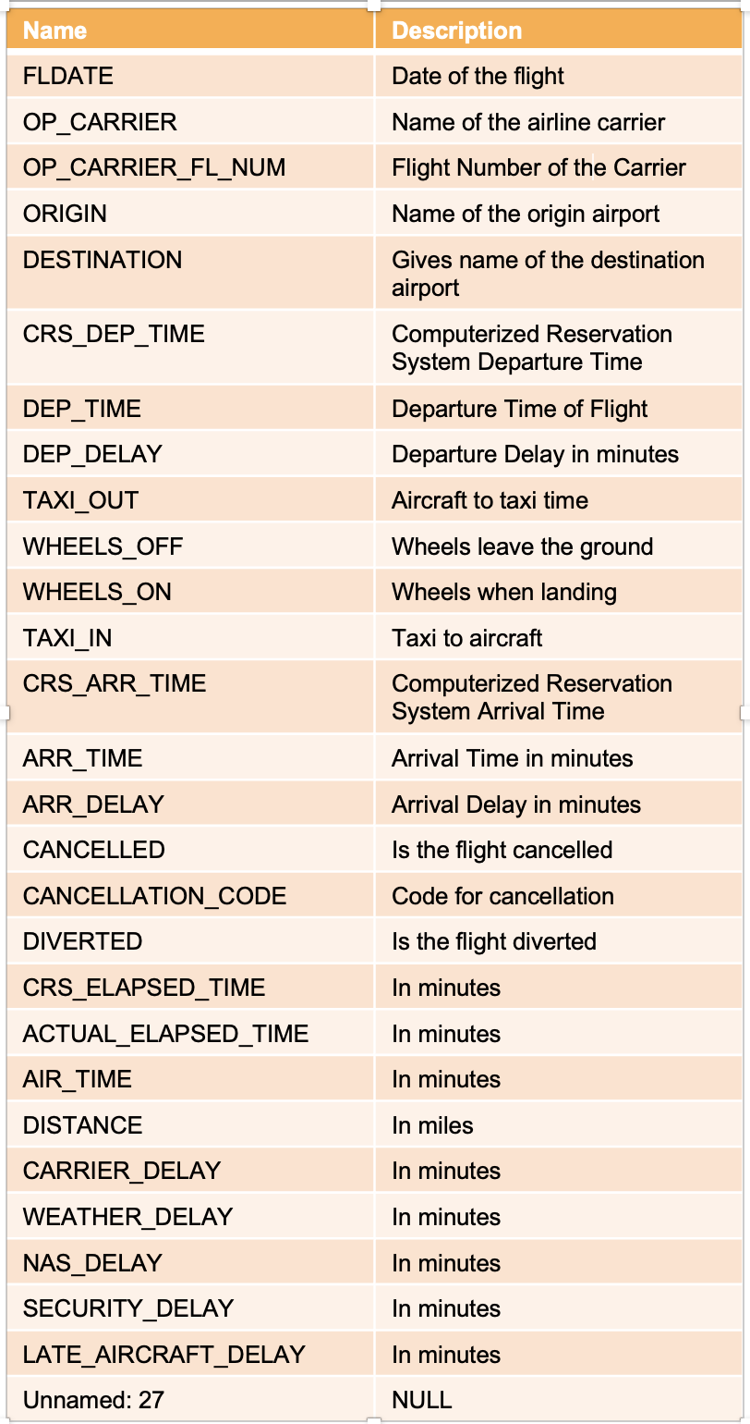
Dataset Description:

Slide 5
Phases of project:
Data Acquisition
Information Extraction and Cleaning
Data Storage
Data Integration, Aggregation, and Representation
Data Modeling and Analysis
Visualization in Tableau by connecting it with MongoDB

Slide 6





Architecture Diagram
We have used the below Technical tools:
Data storage Tool
Data Source
Tool for Data Processing
Environment
Data Visualization Tool

Slide 7
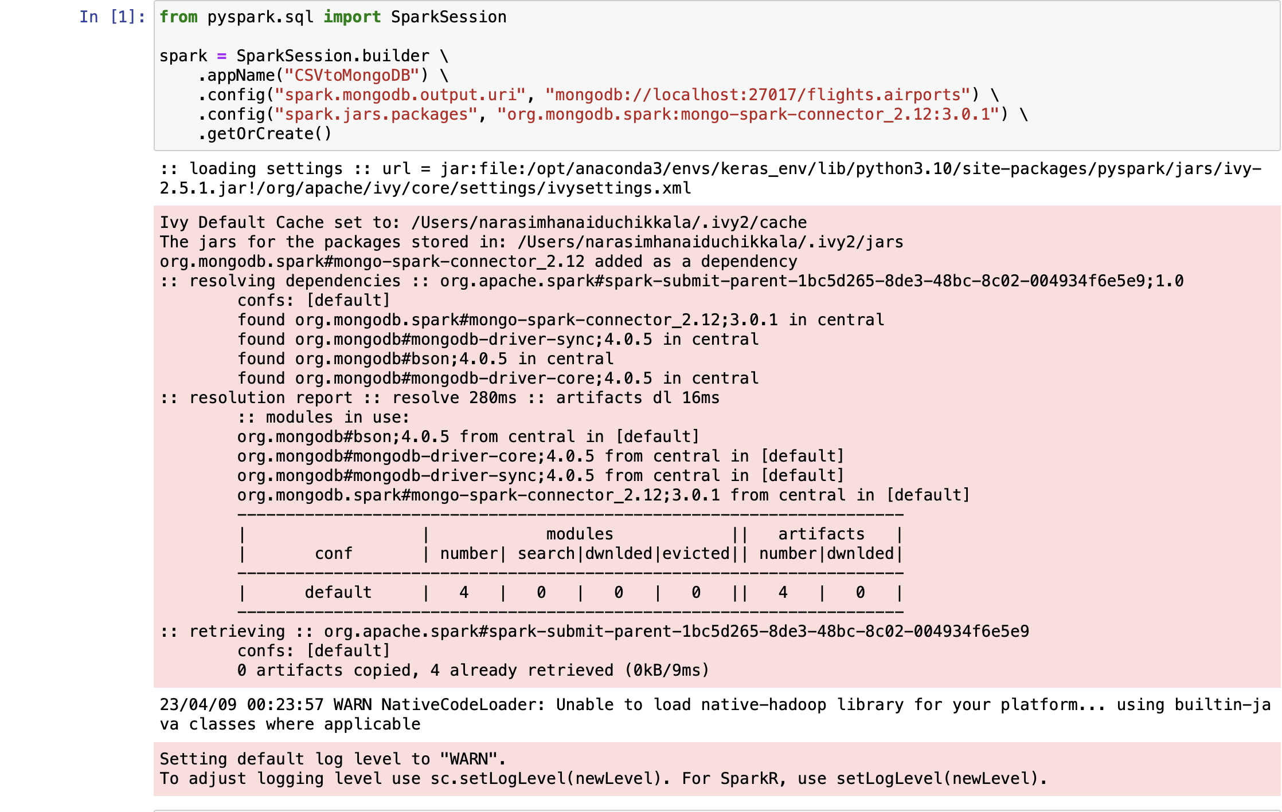
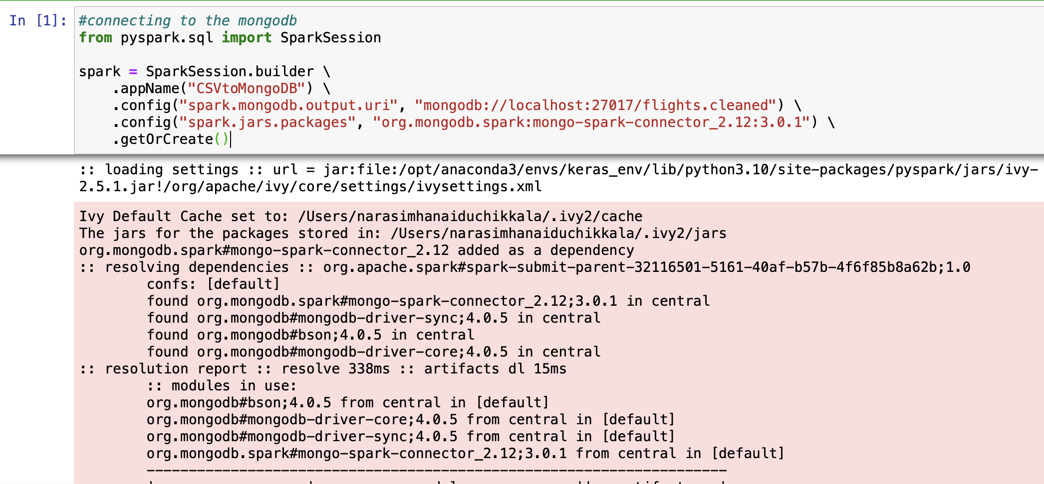
MongoDB Connection

Slide 8
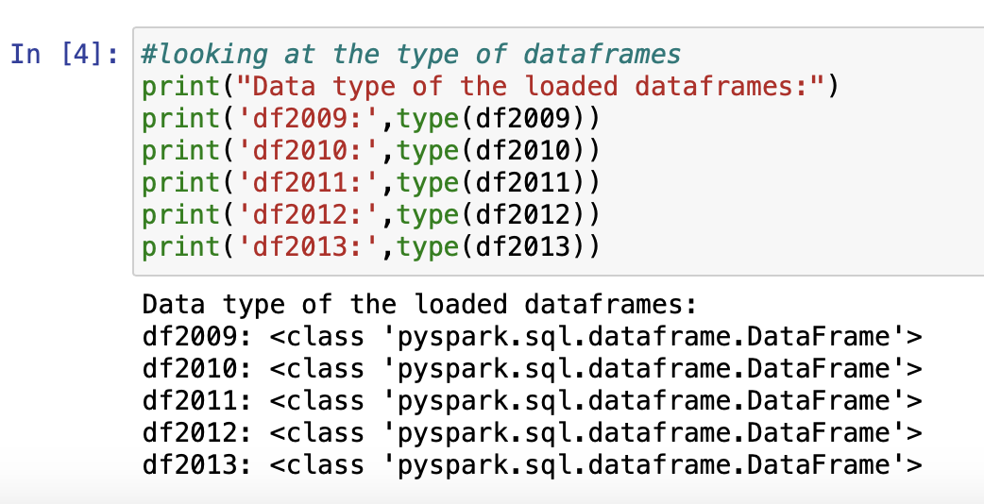
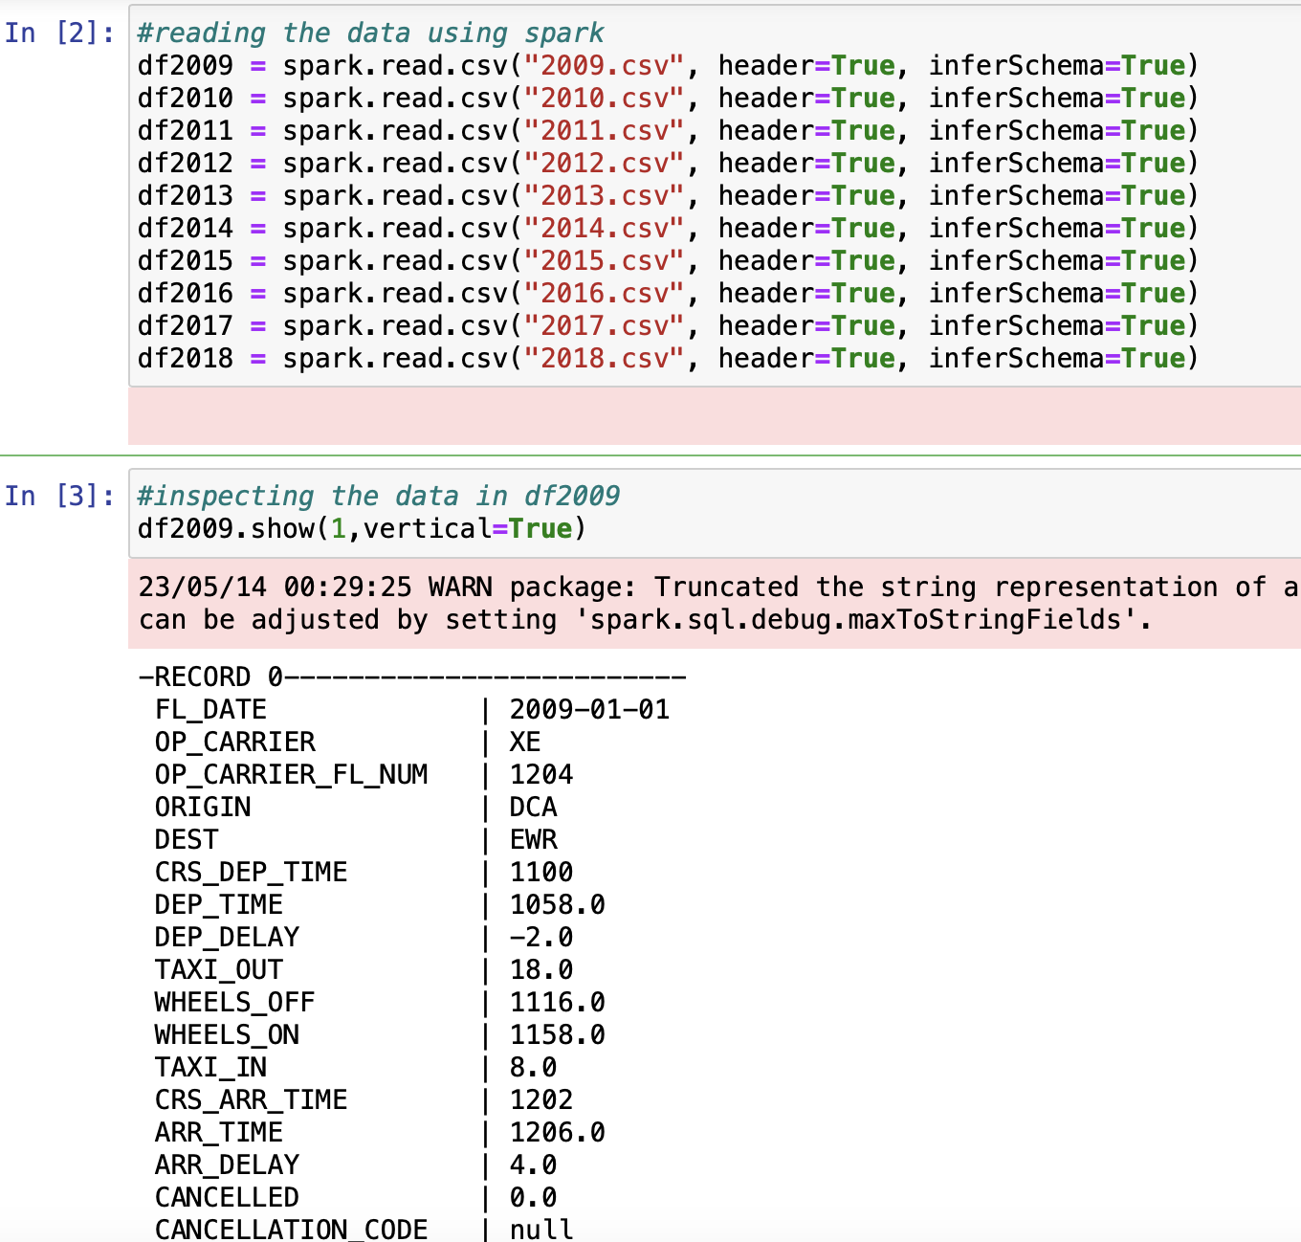
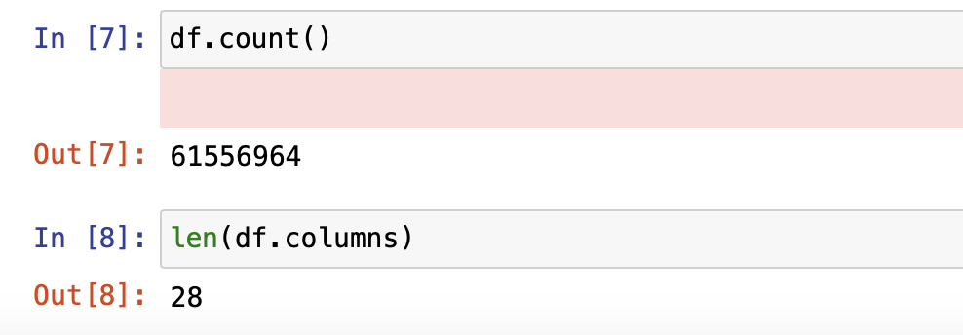
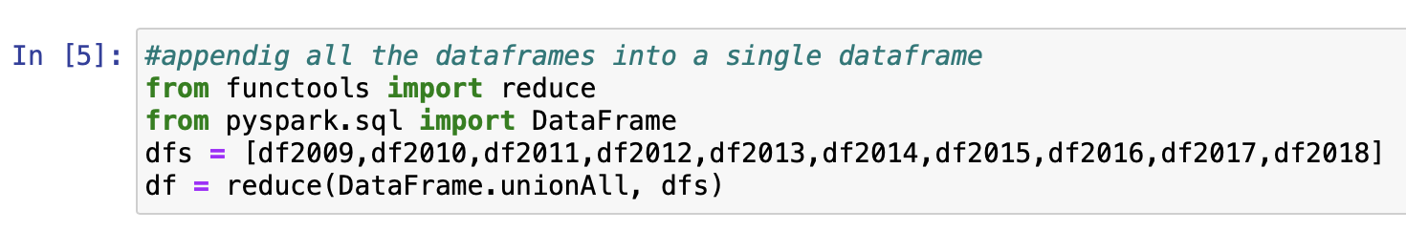
Pre-processing using PySpark

Slide 9
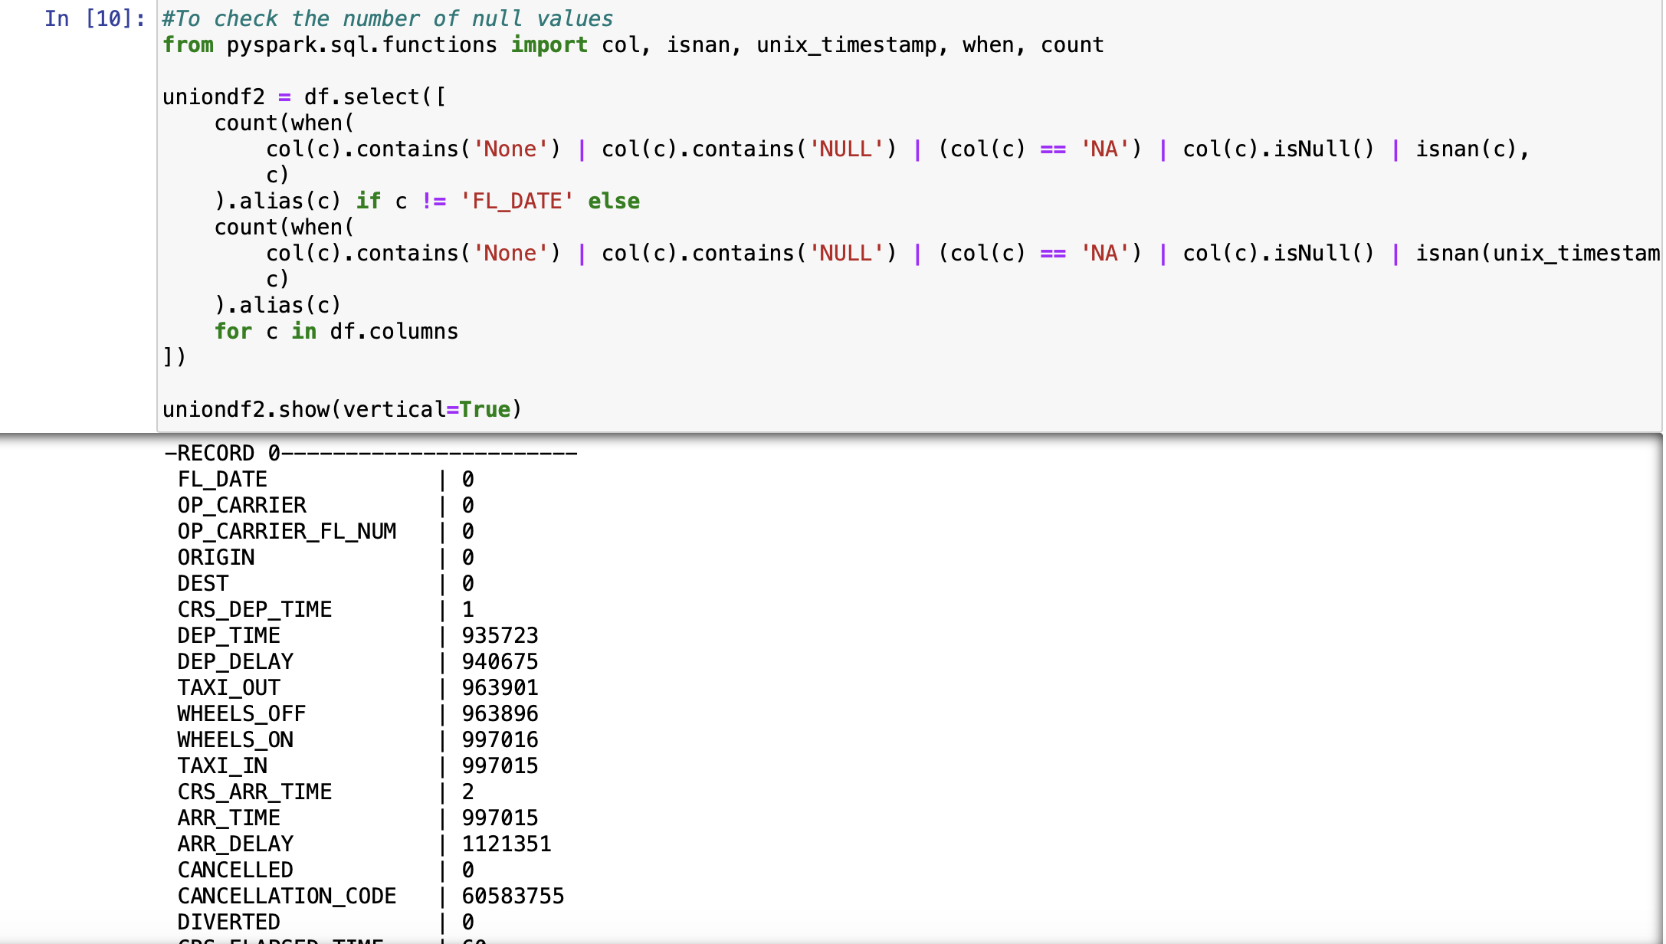
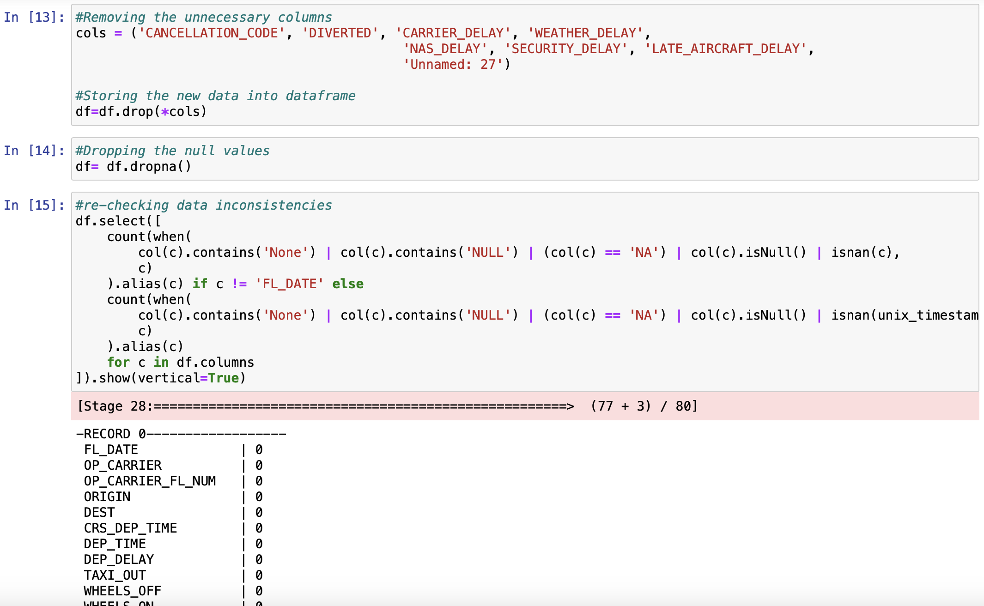
Data Cleaning

Slide 10
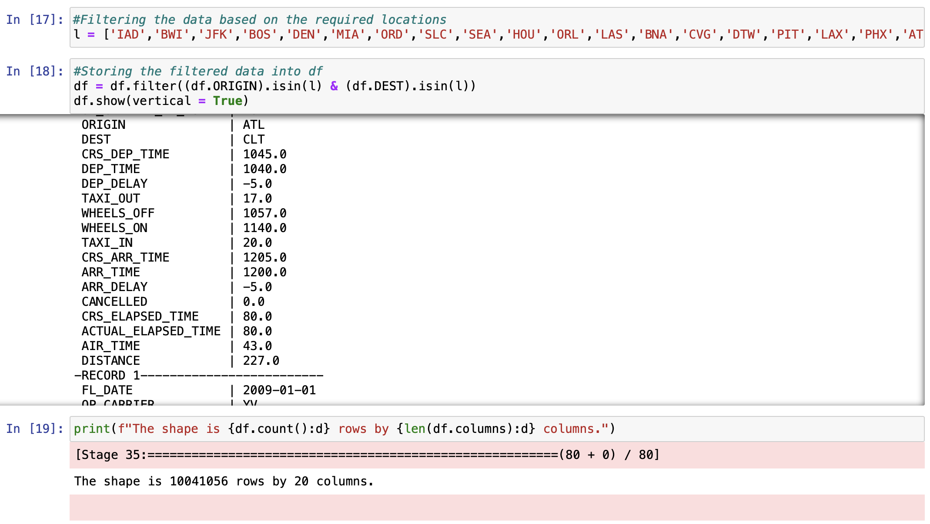
Data Filtering based on required airports

Slide 11
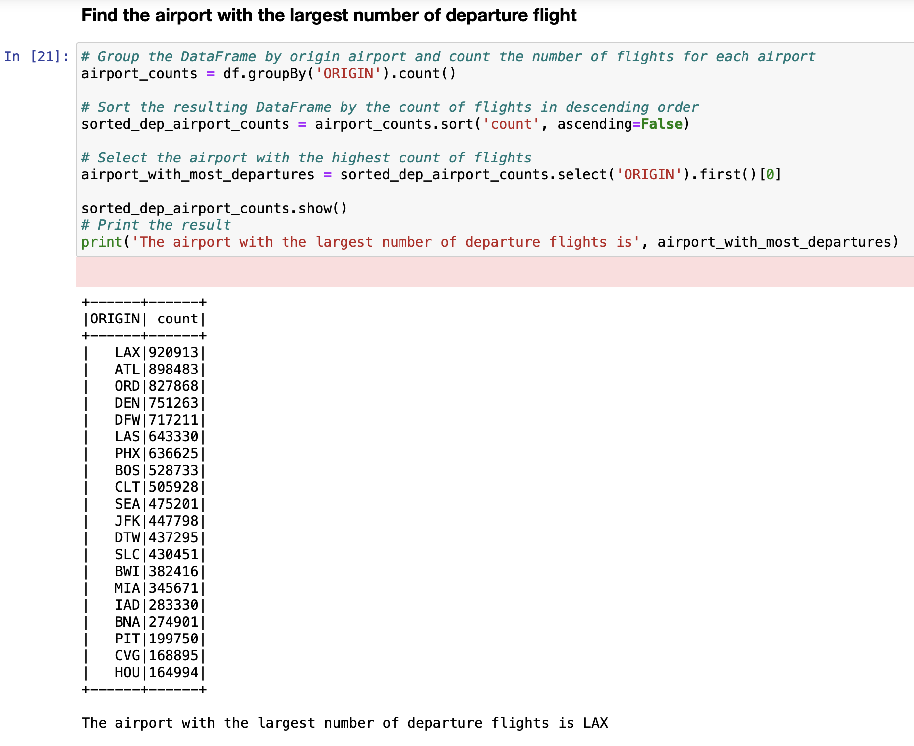
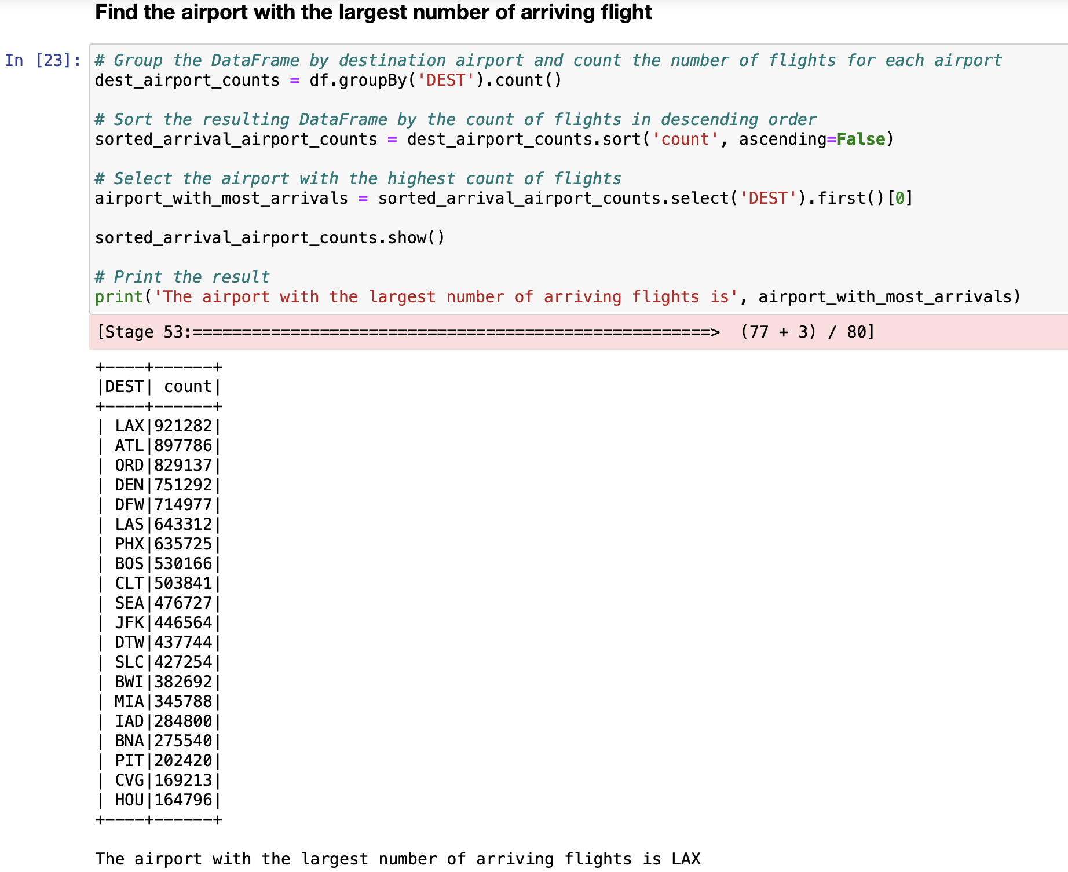
Exploratory Data Analysis

Slide 12
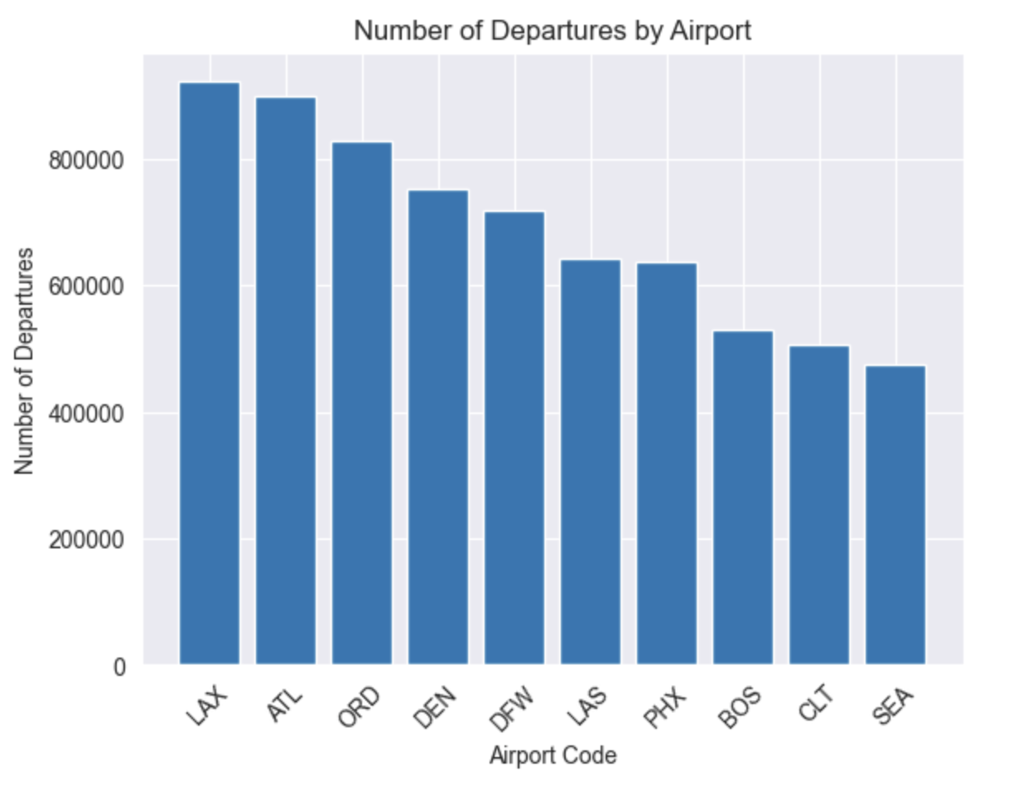
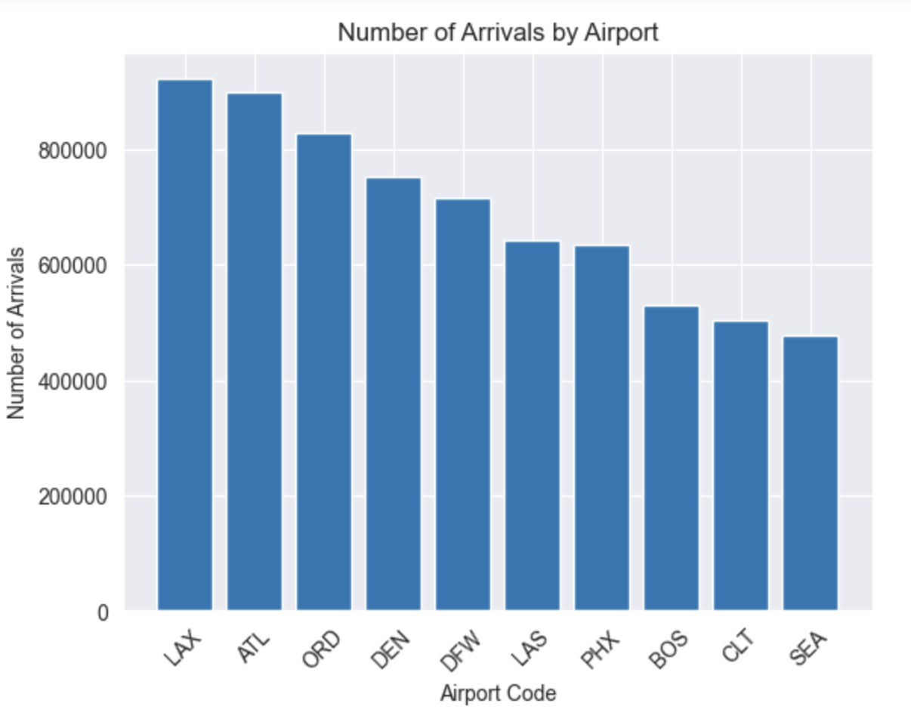
Data Visualization

Slide 13
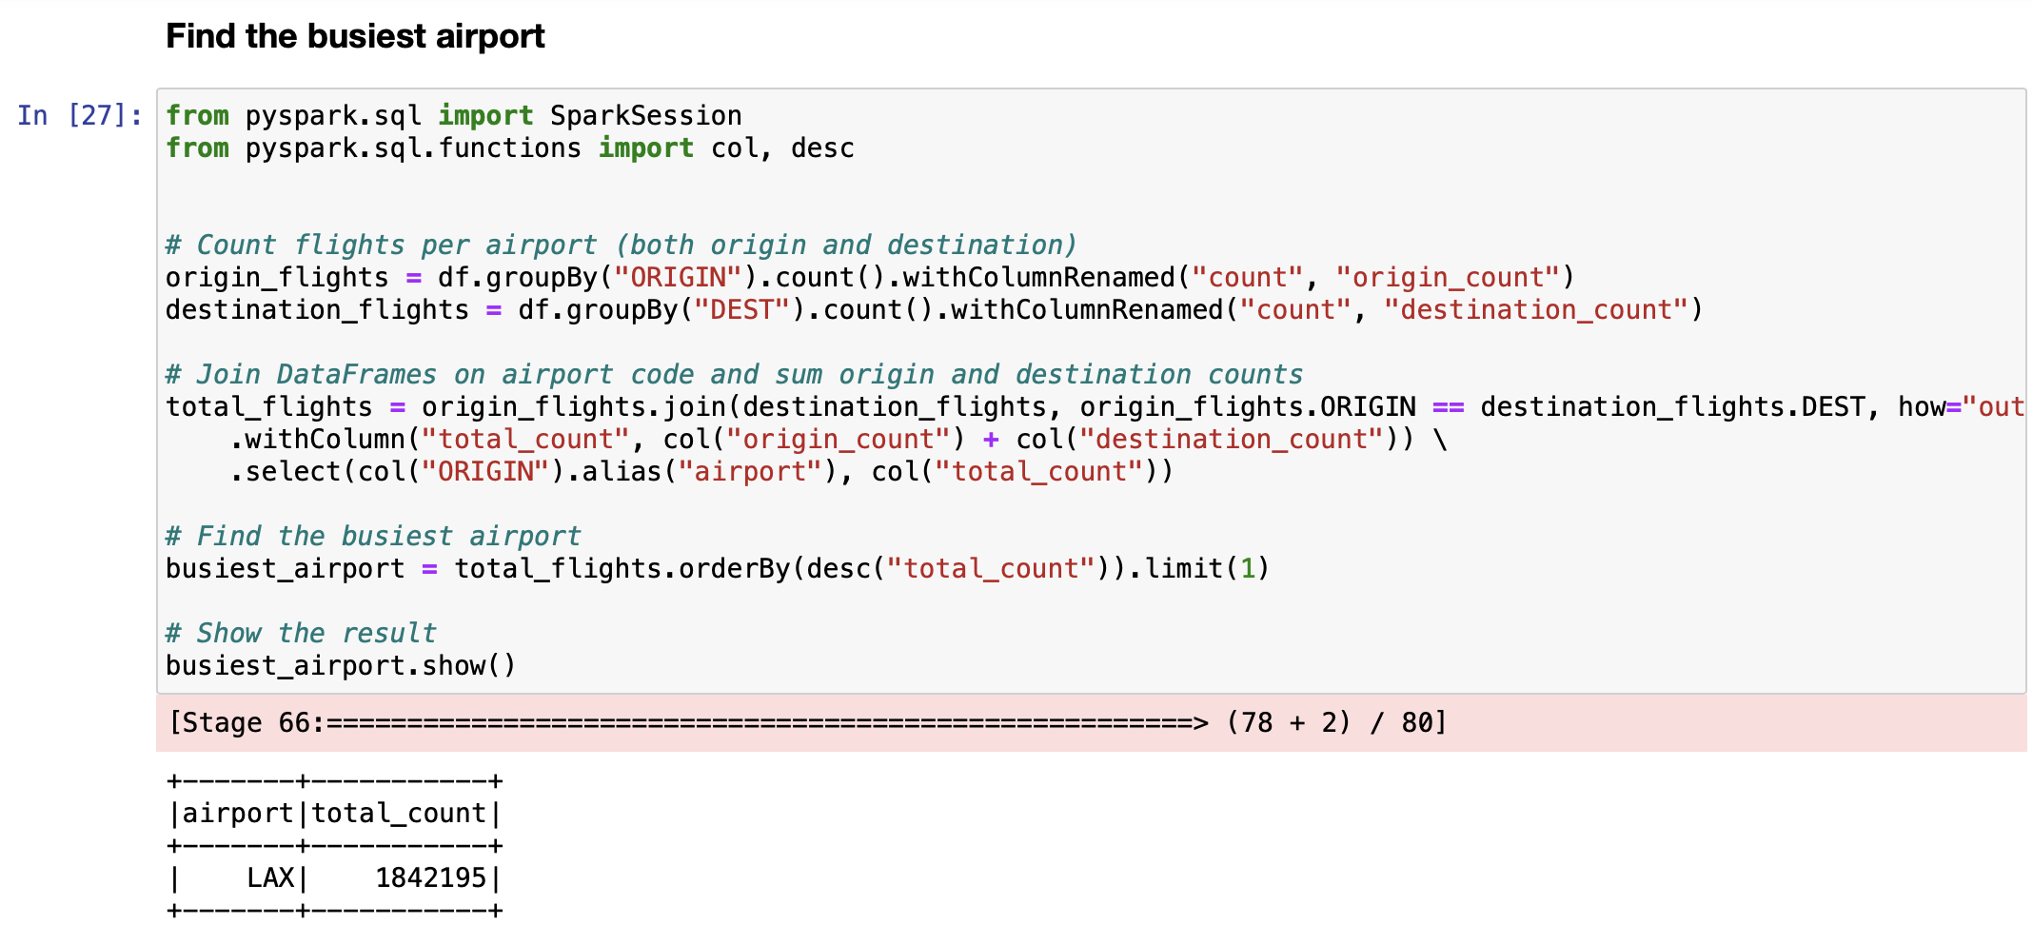
Exploratory Data Analysis

Slide 14
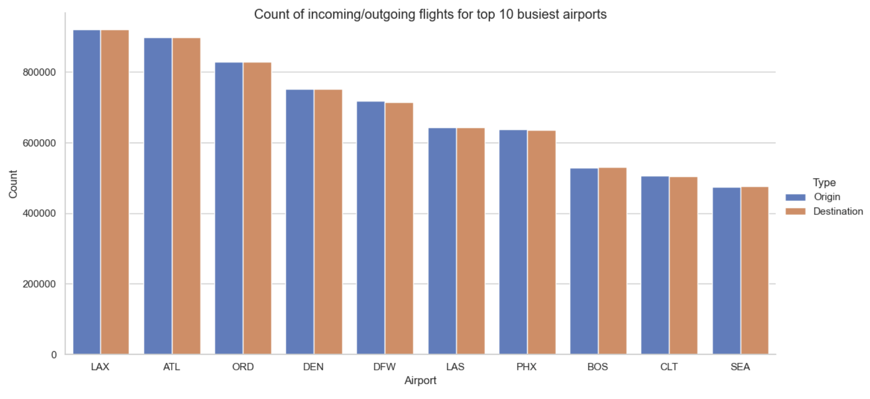
Data Visualization

Slide 15
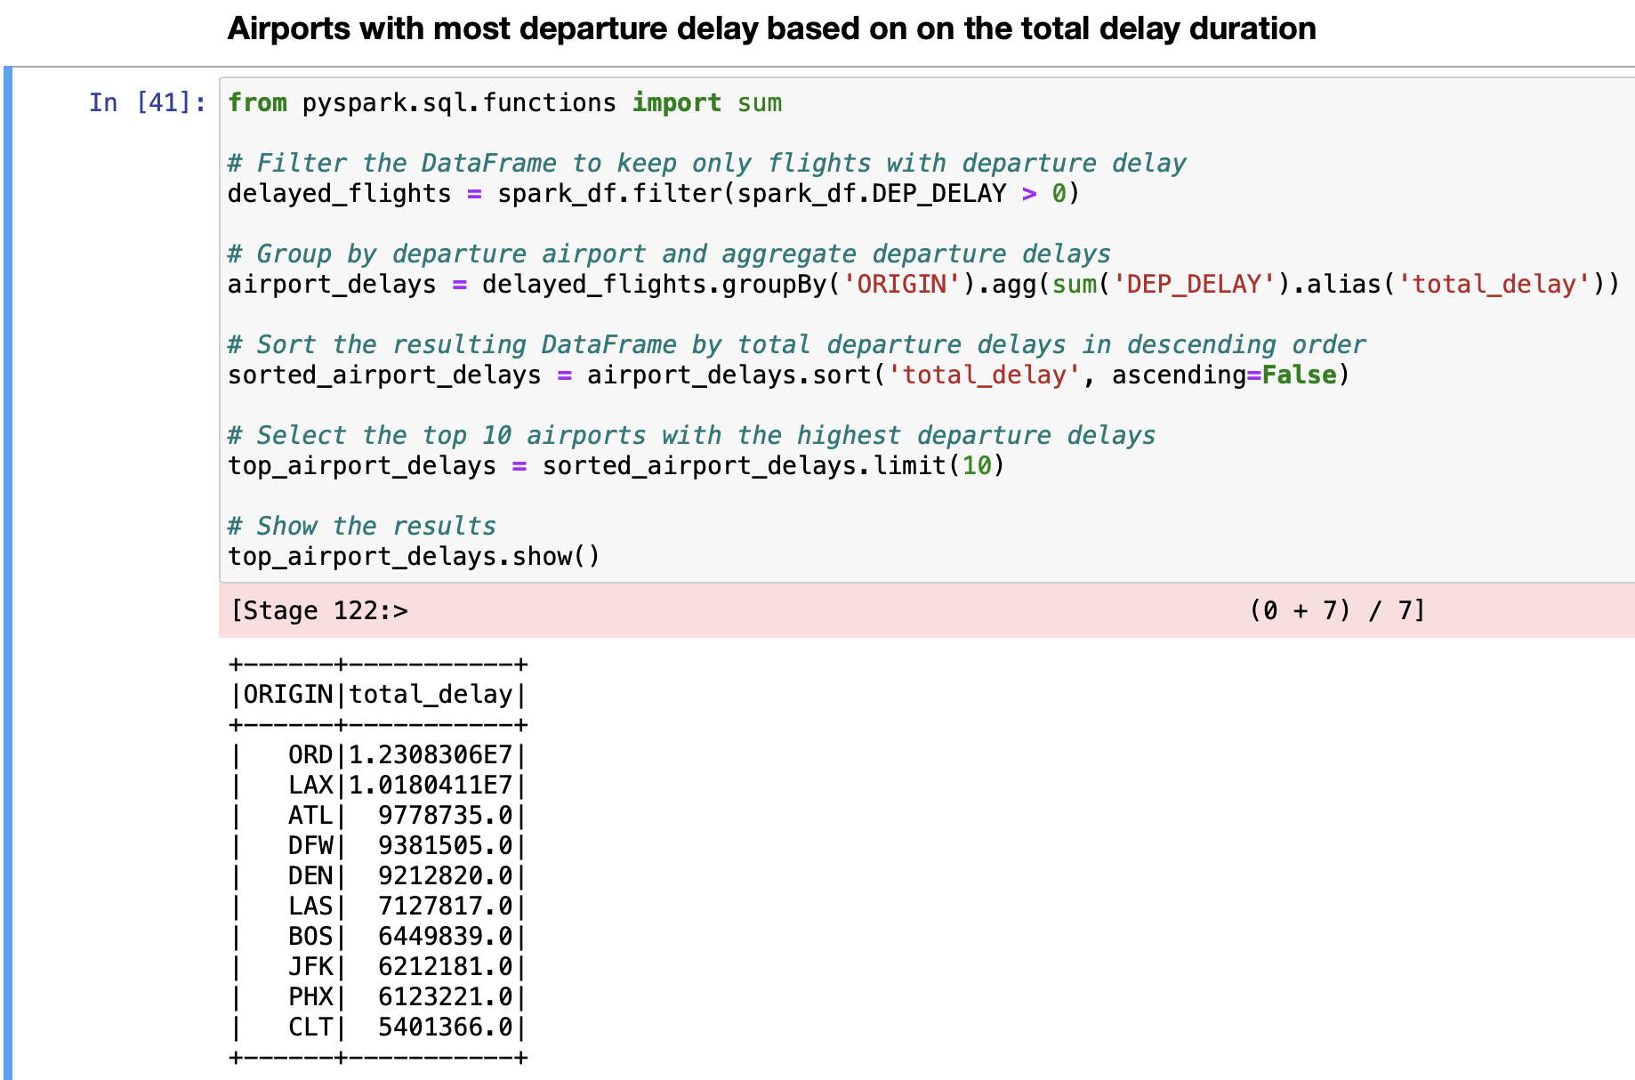
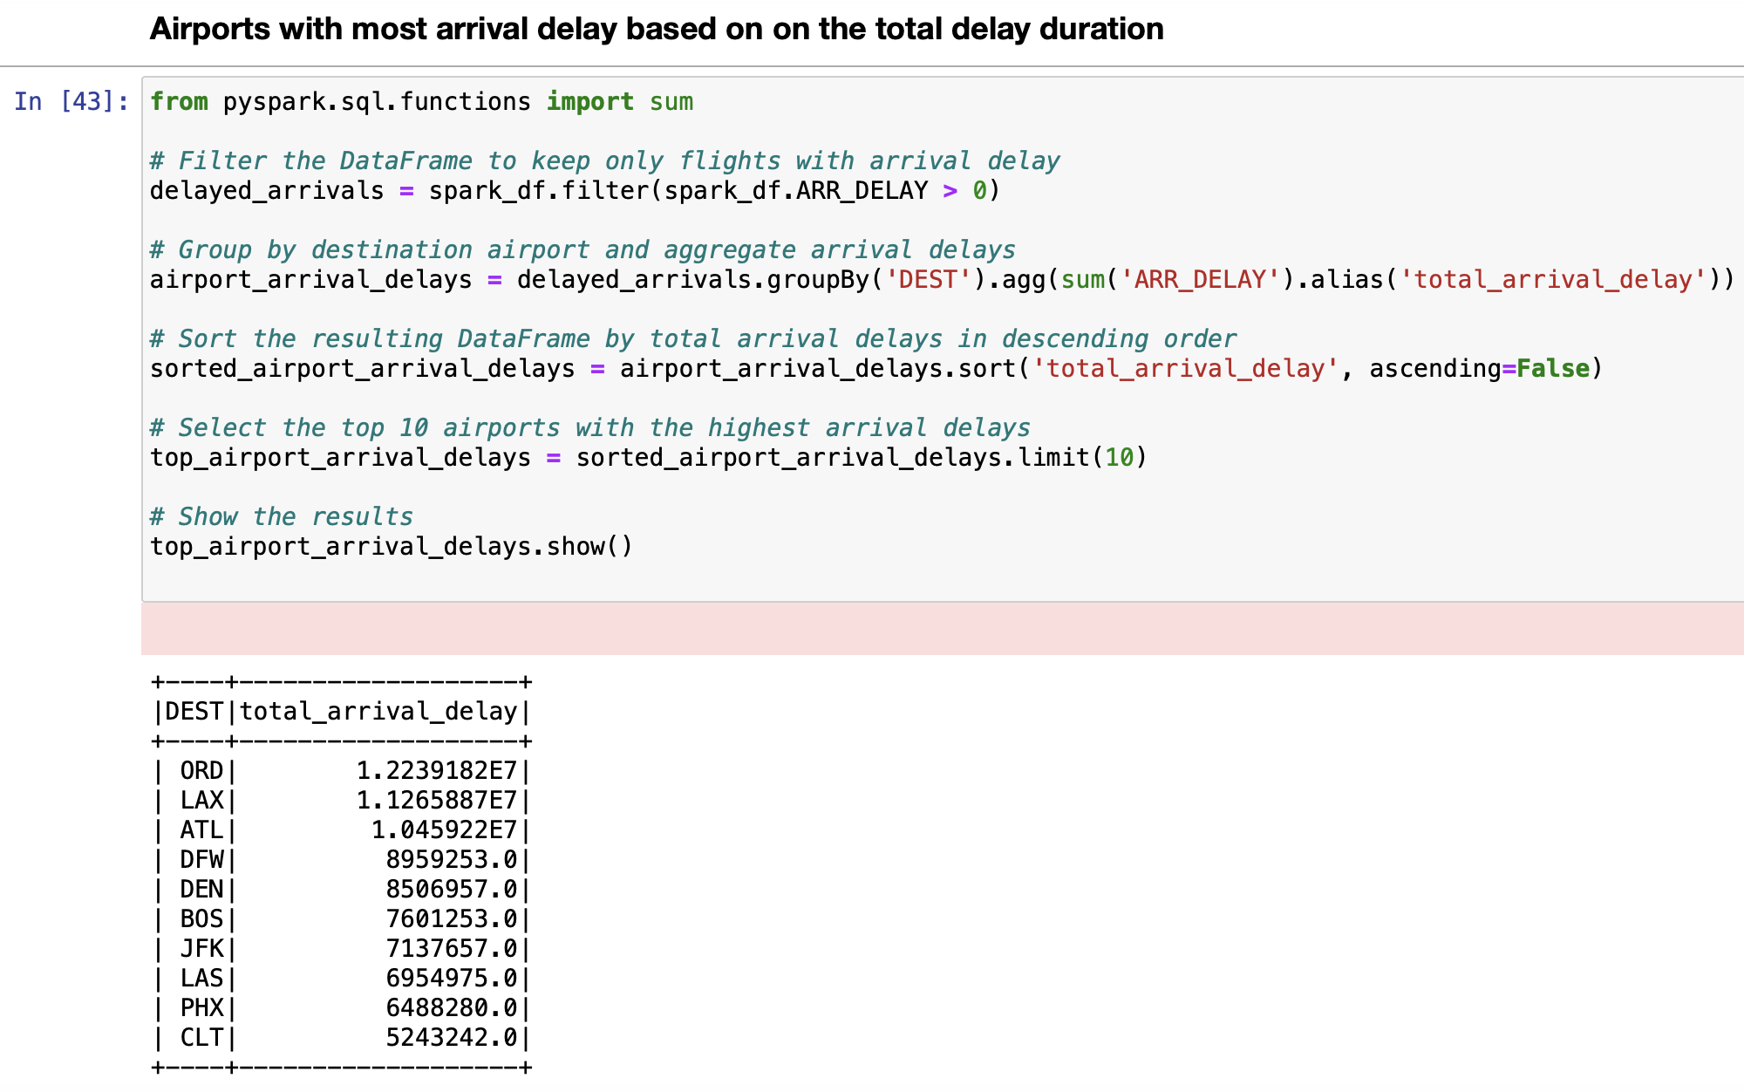
Exploratory Data Analysis

Slide 16
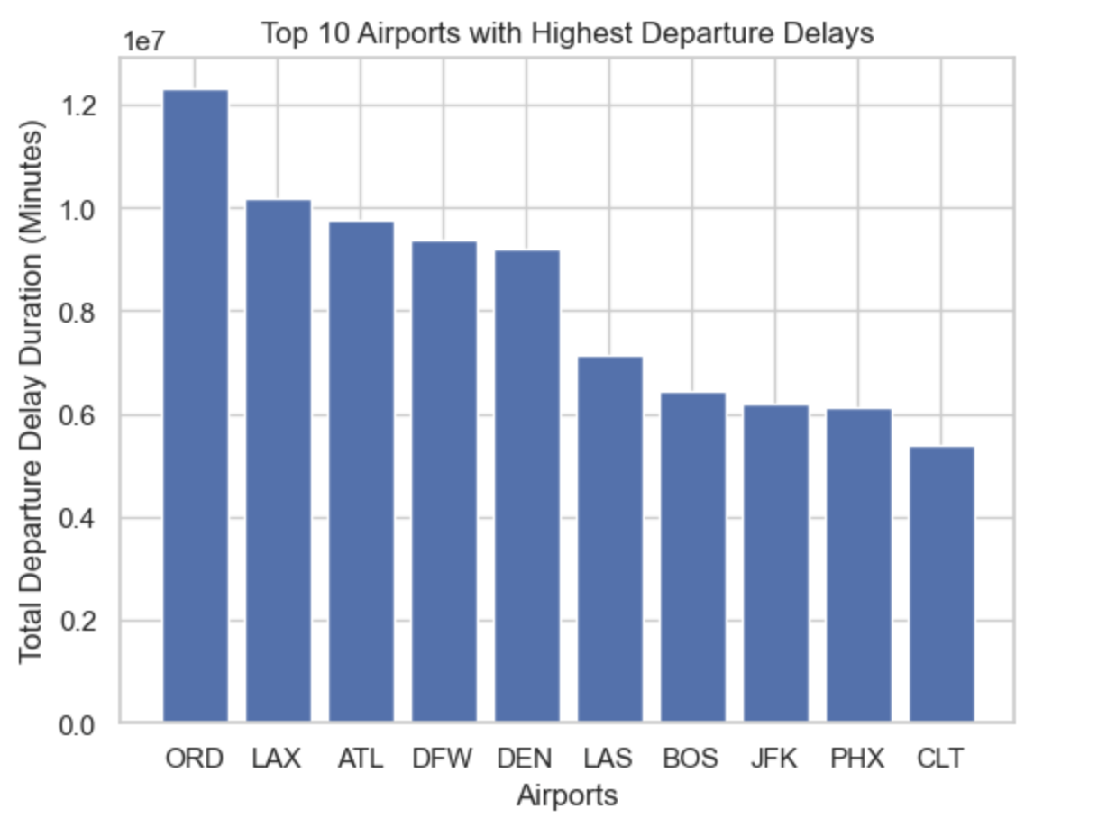
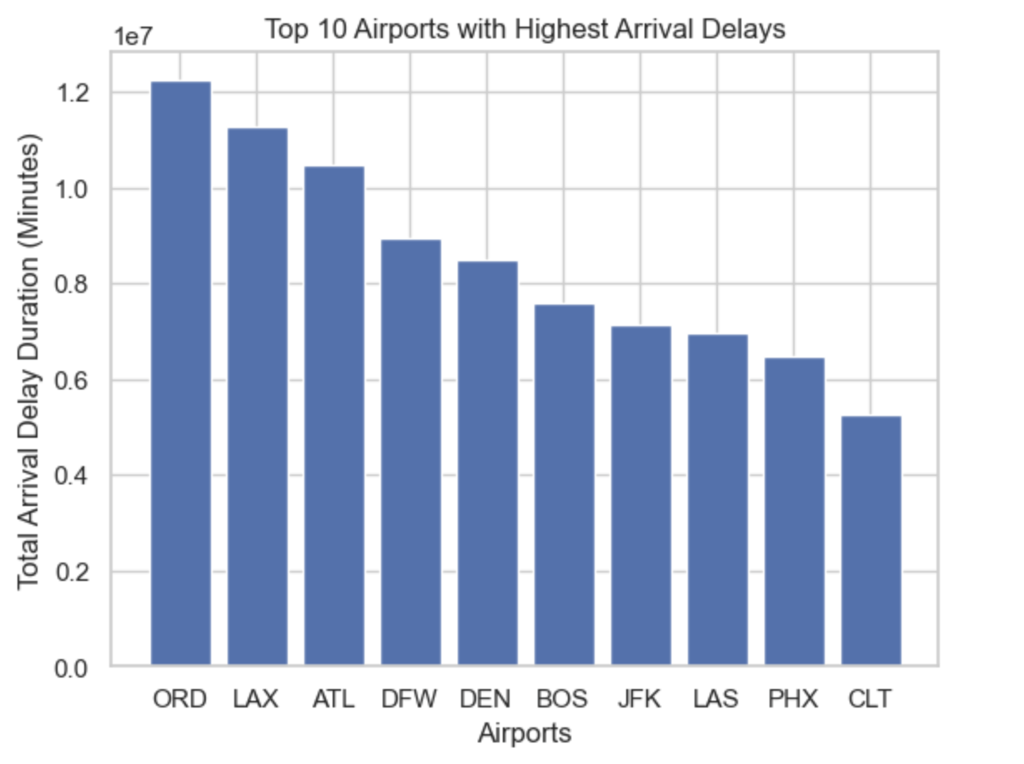
Data Visualization

Slide 17
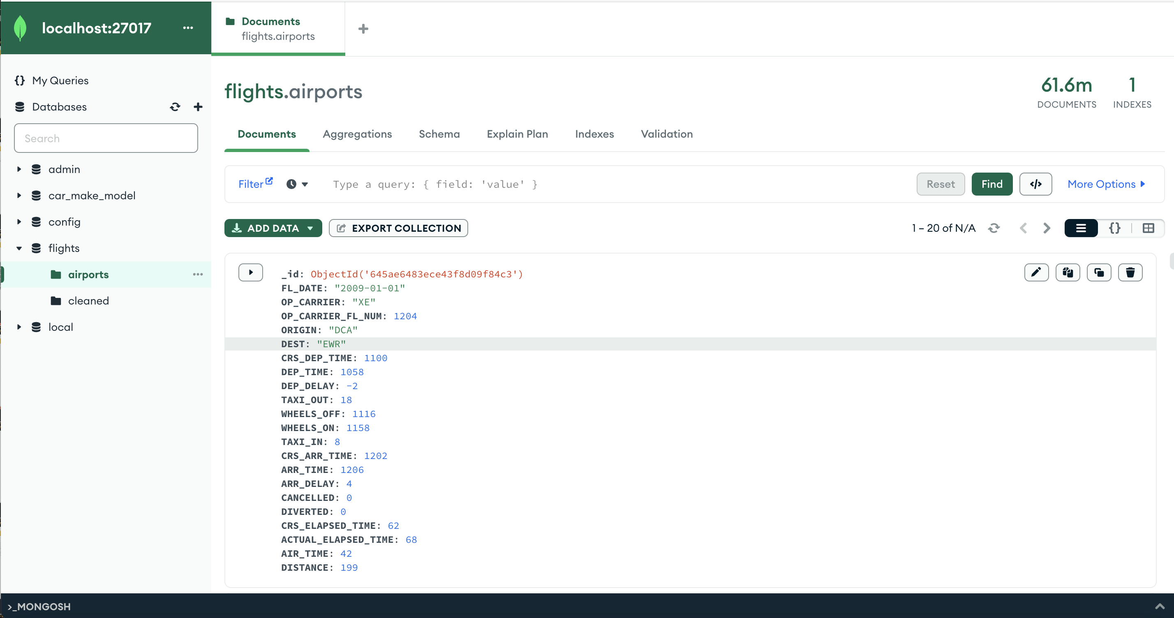
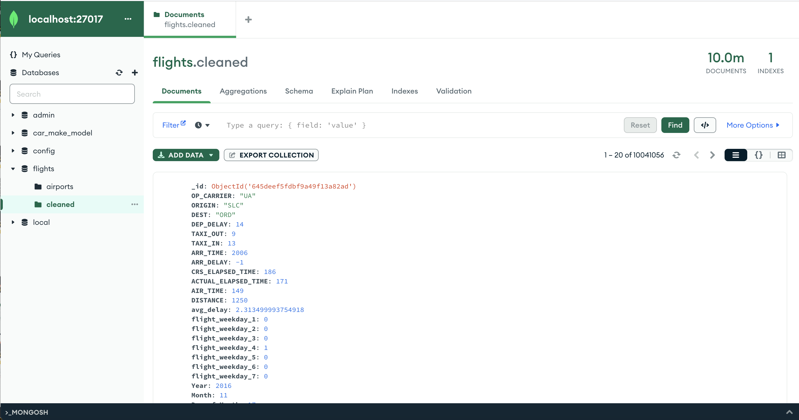
Writing to MongoDB Collection
Entire Data:
Cleaned Data:

Slide 18
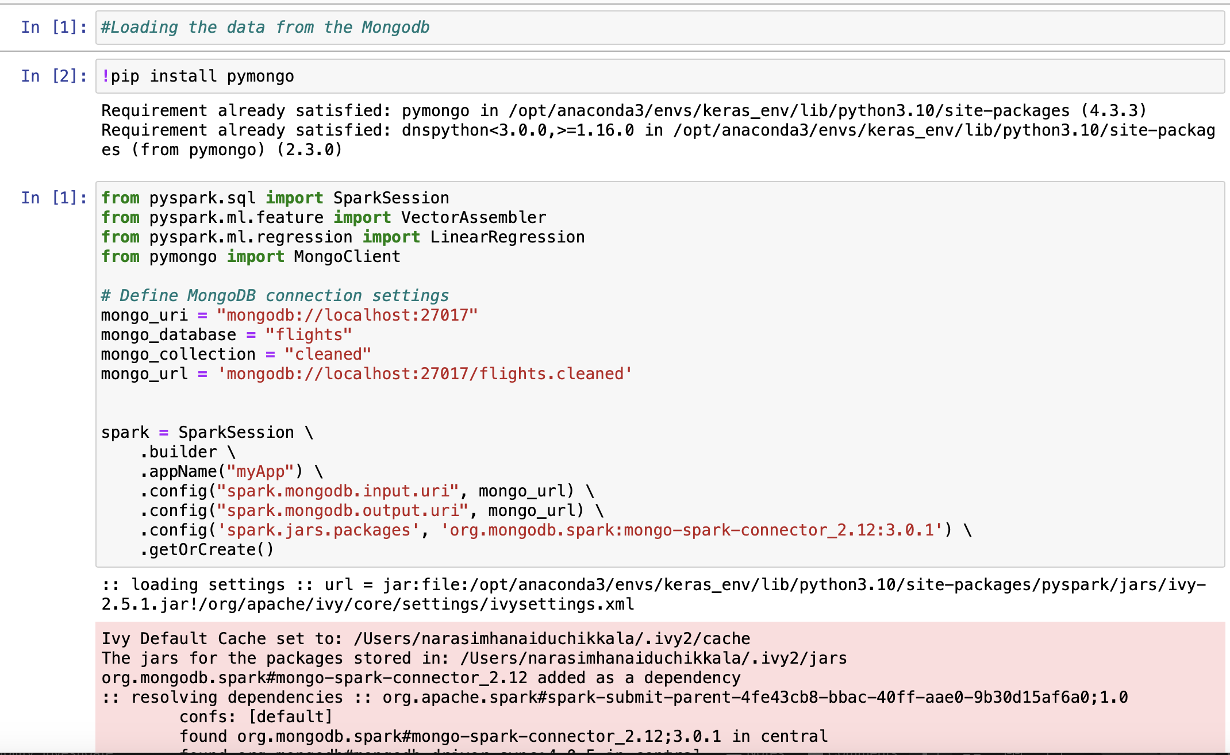
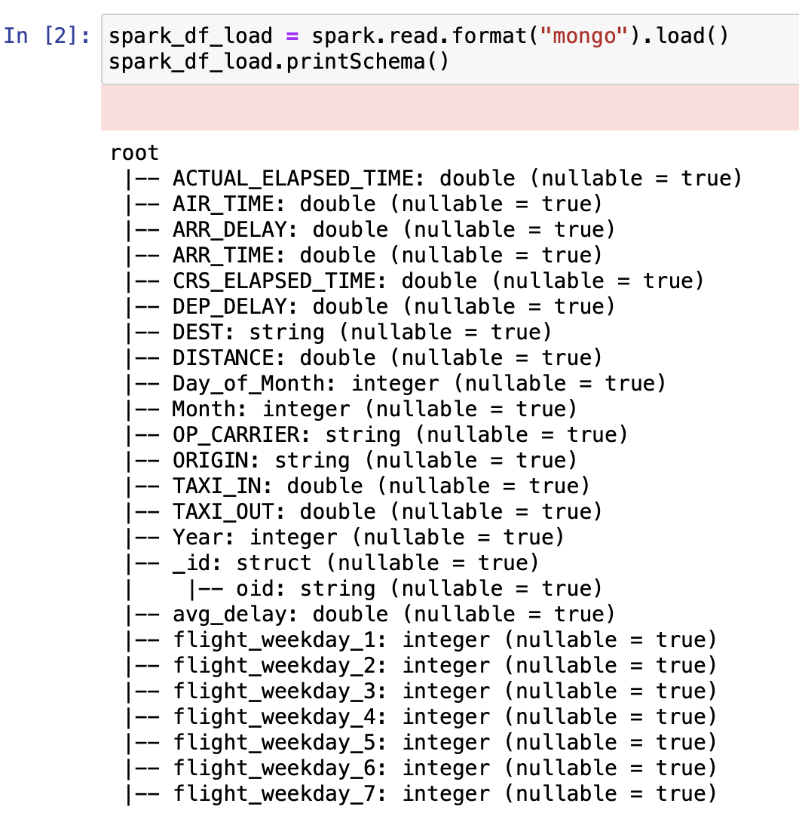
Loading the Cleaned Data from MongoDB

Slide 19
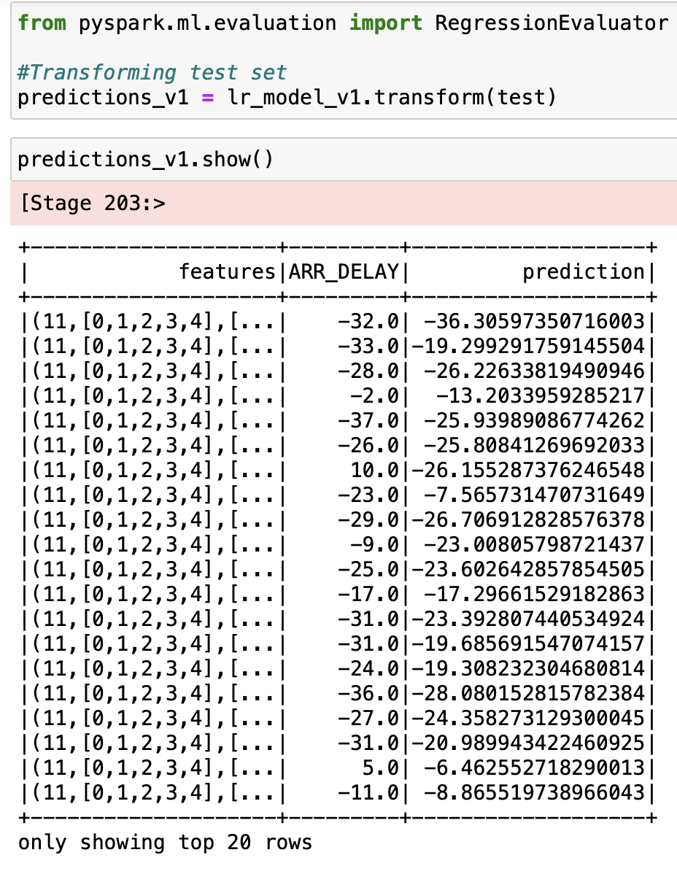
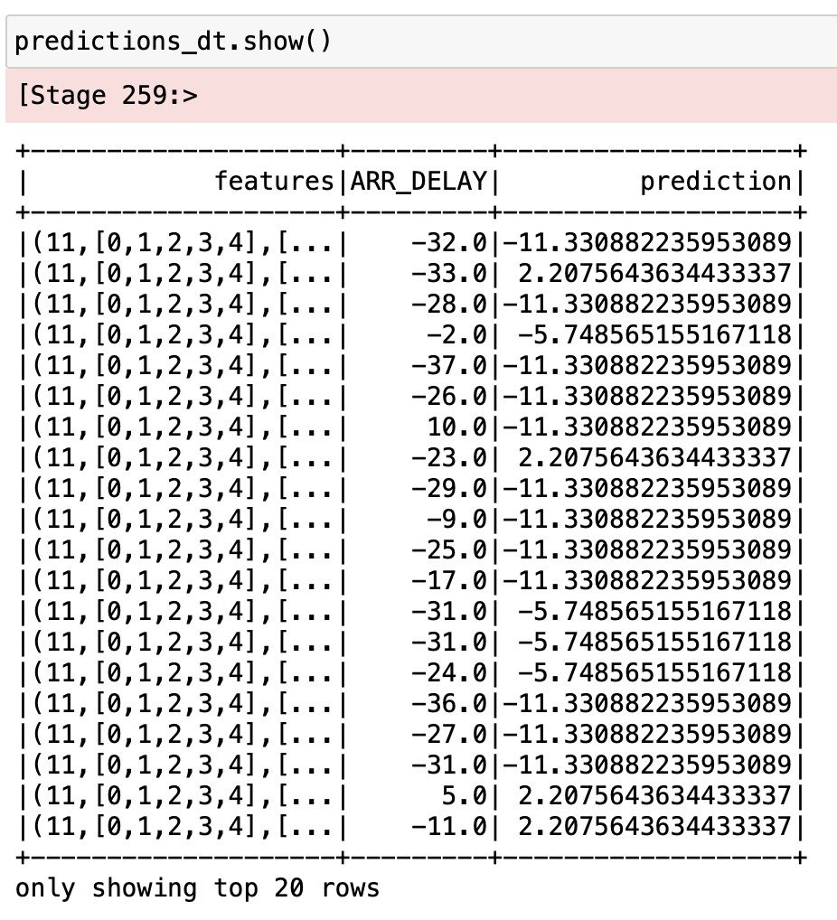
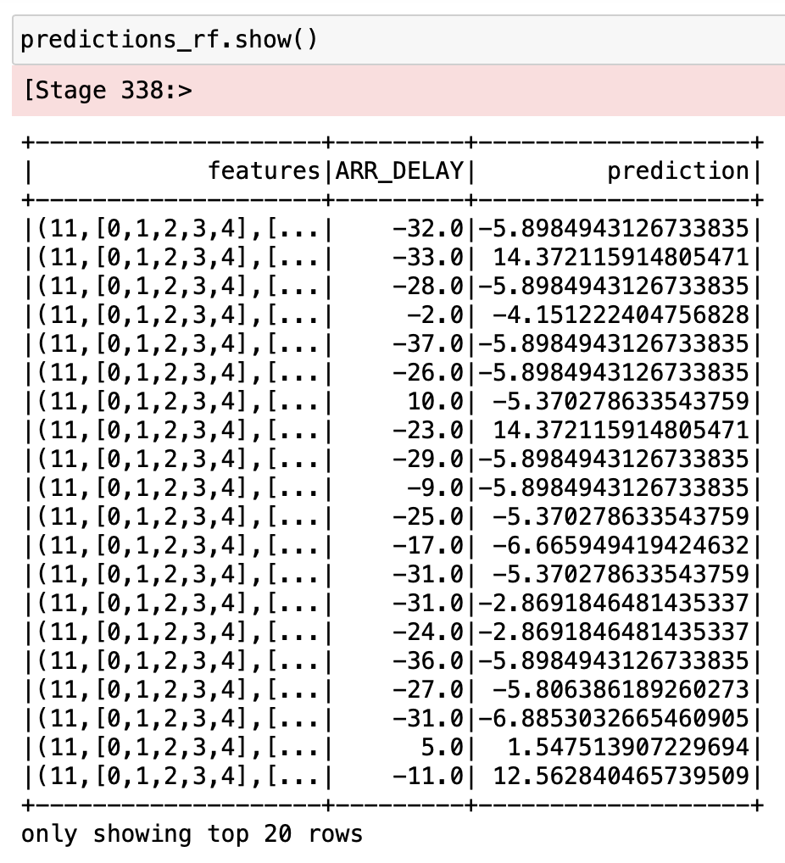
Predictions of ARR DELAY
Linear Regression
Decision Tree Regressor
Random Forest Regressor

Slide 20
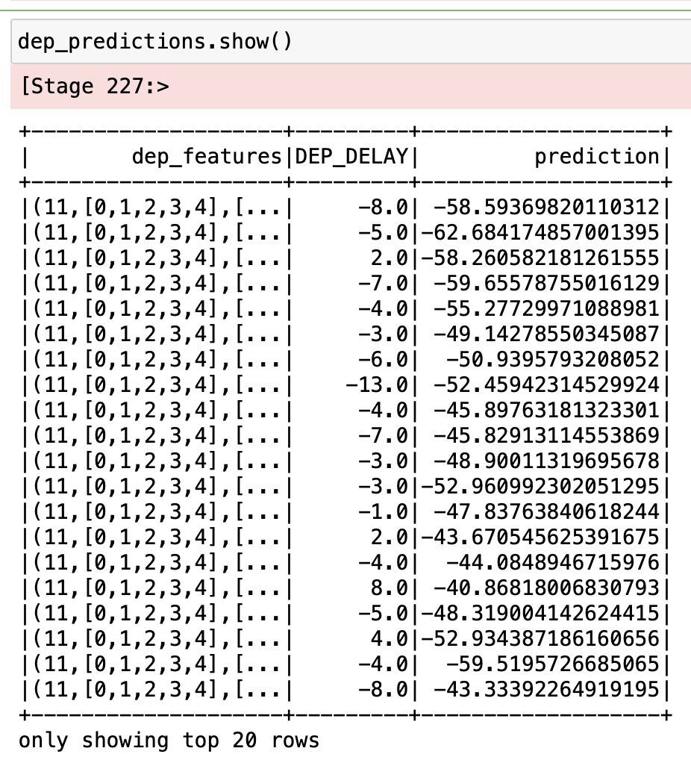
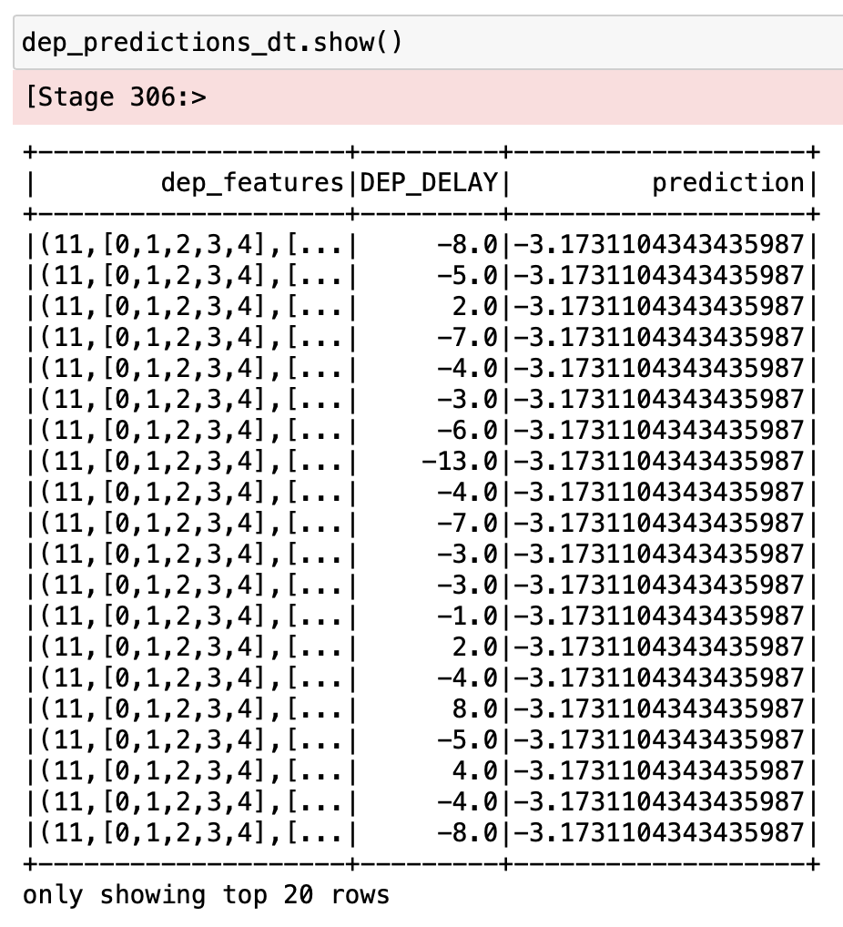
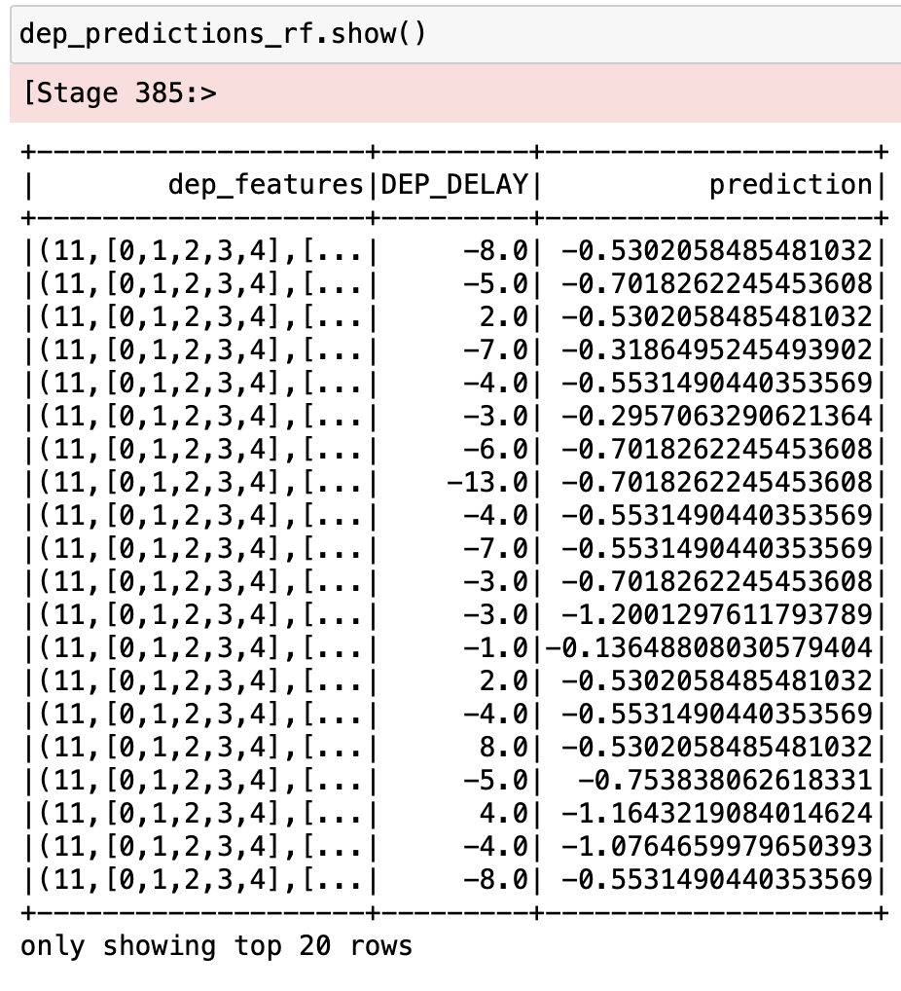
Predictions of DEP DELAY
Linear Regression
Decision Tree Regressor
Random Forest Regressor
Note :- Here the predictions may not be accurate for top 20 rows but for overall data the prediction is good which can be observed through RMSE and r2 scores.

Slide 21
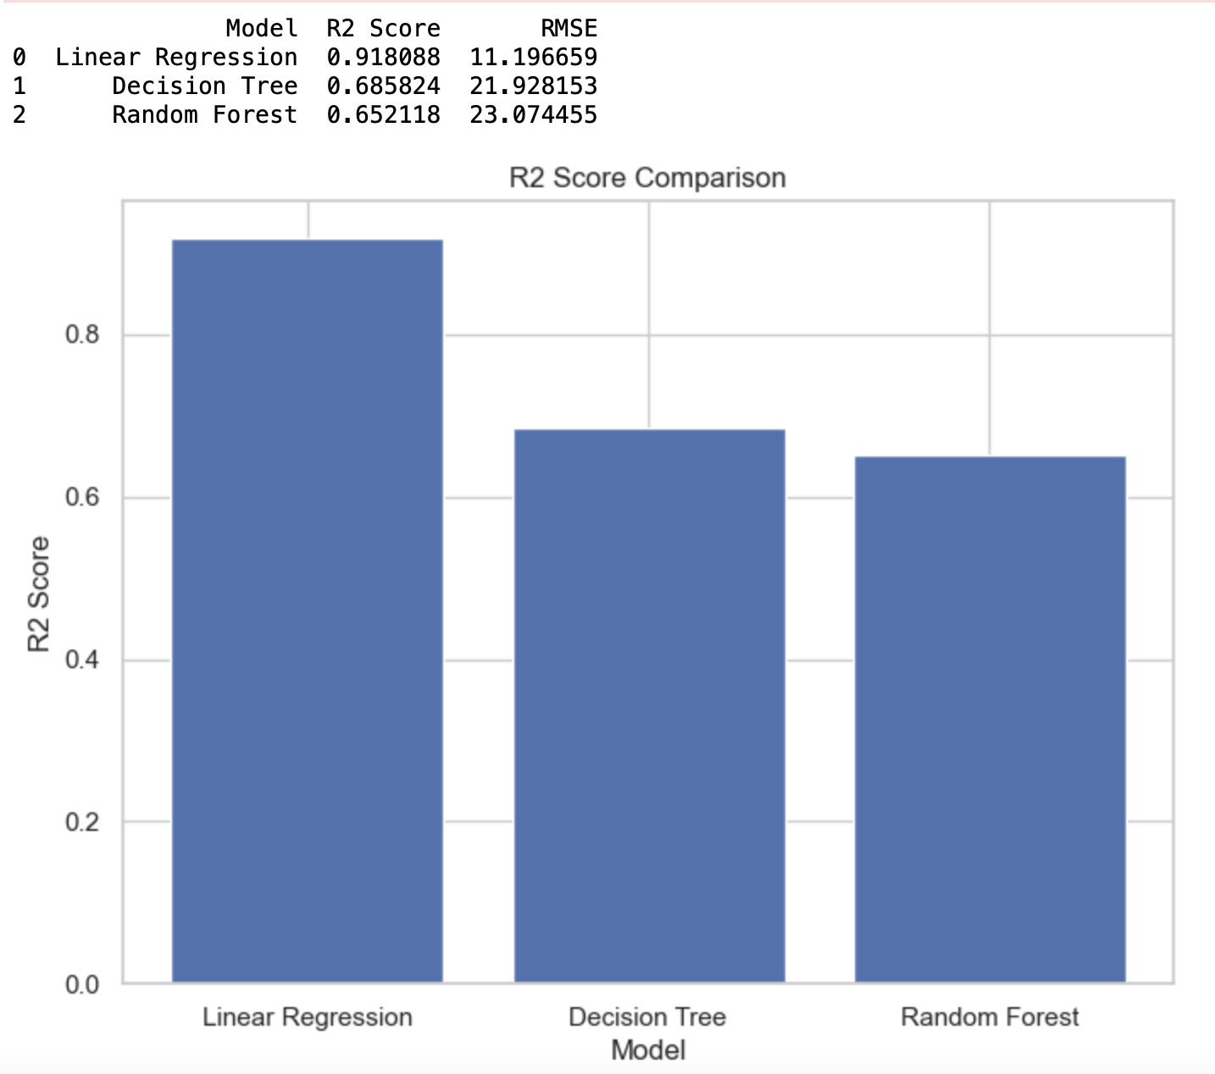
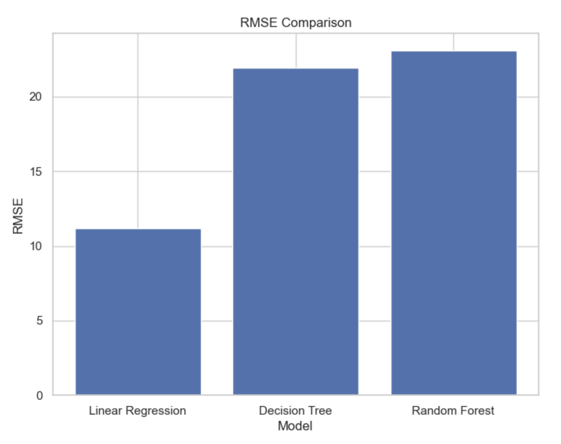
Comparison of ARR DELAY Predictions

Slide 22
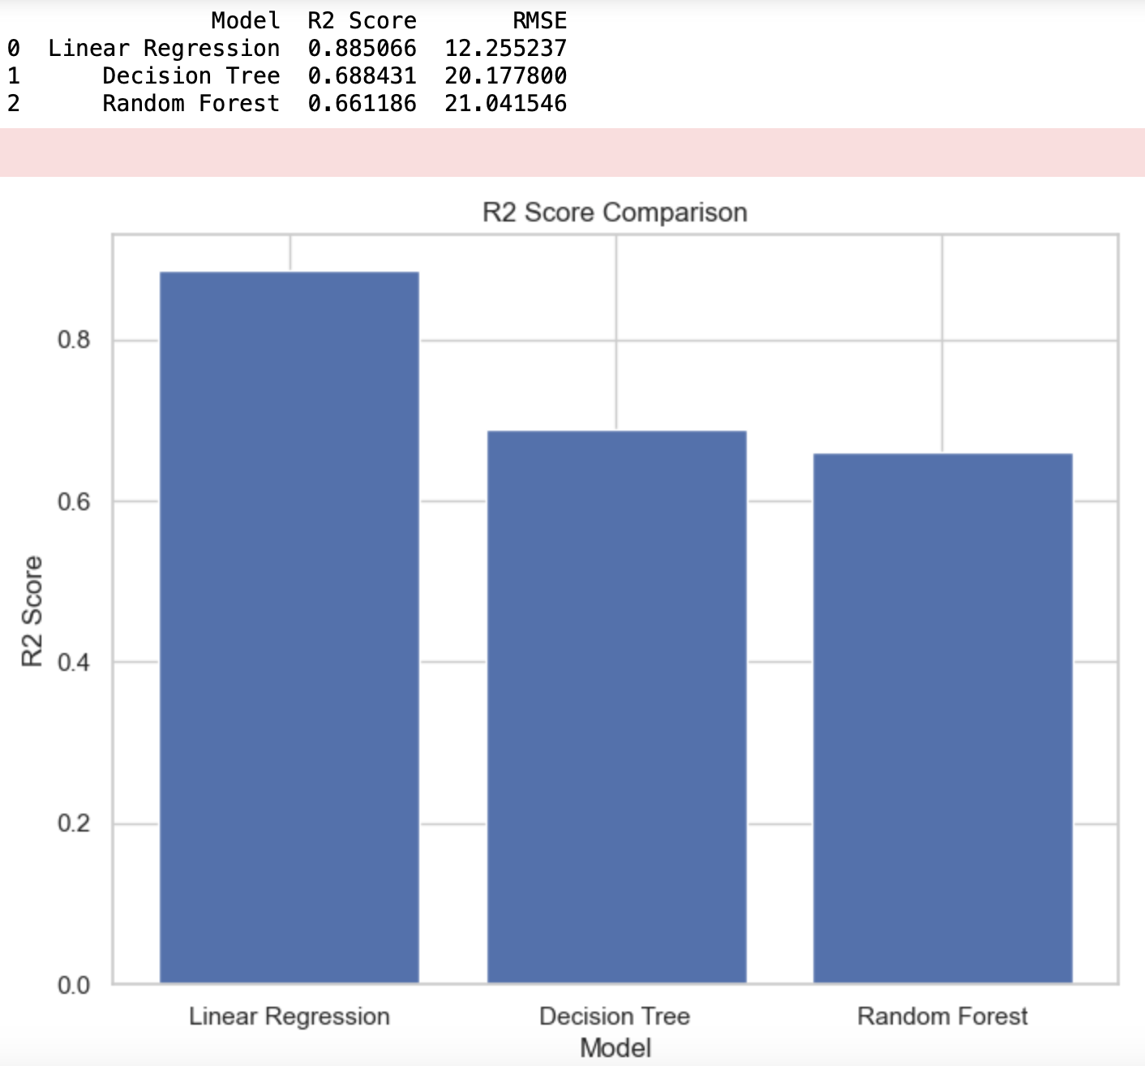
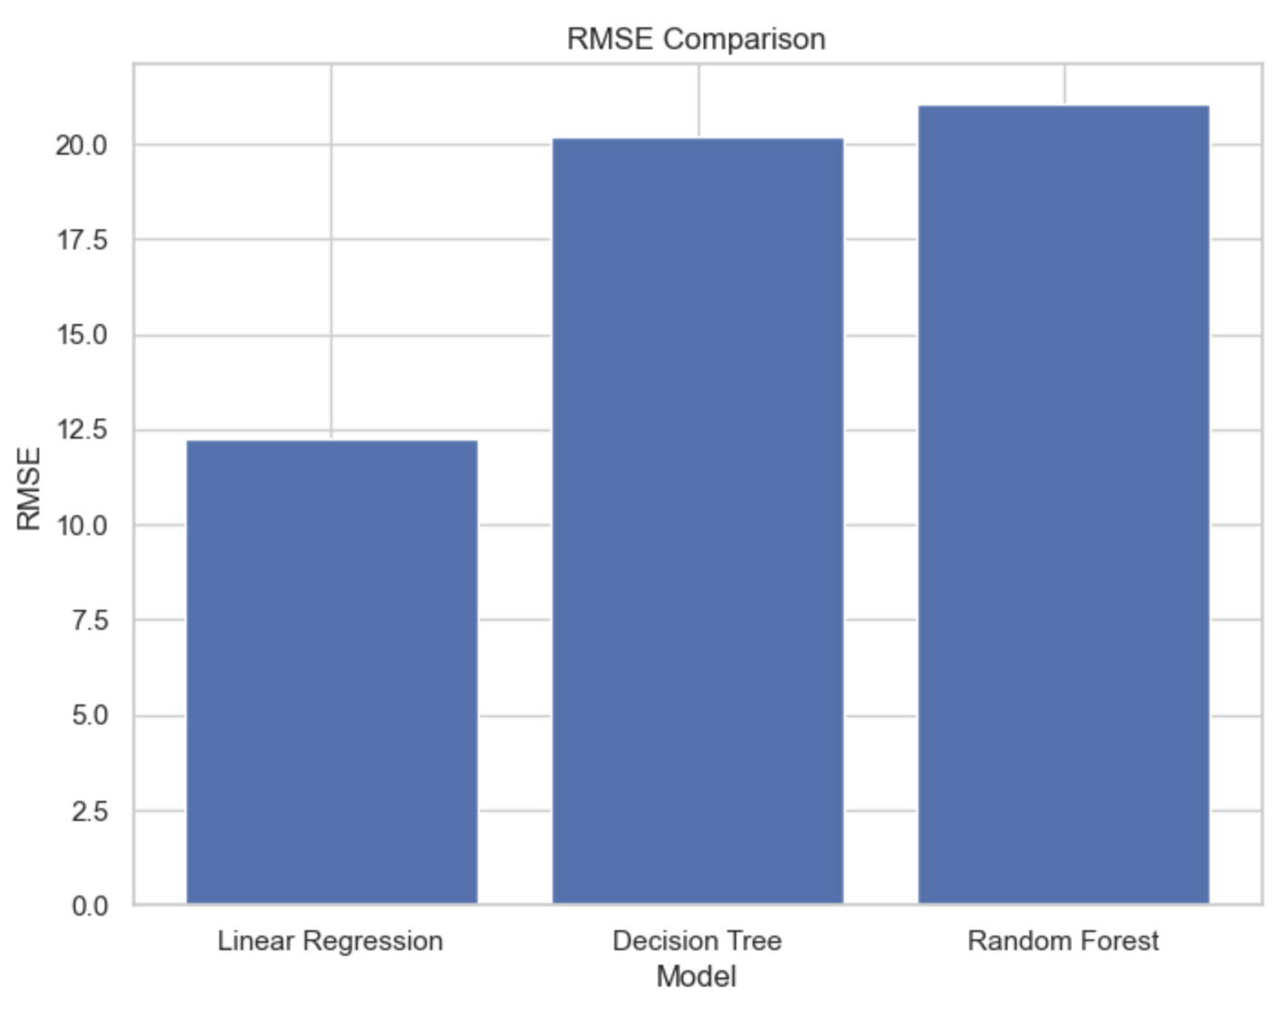
Comparison of DEP DELAY Predictions

Slide 23
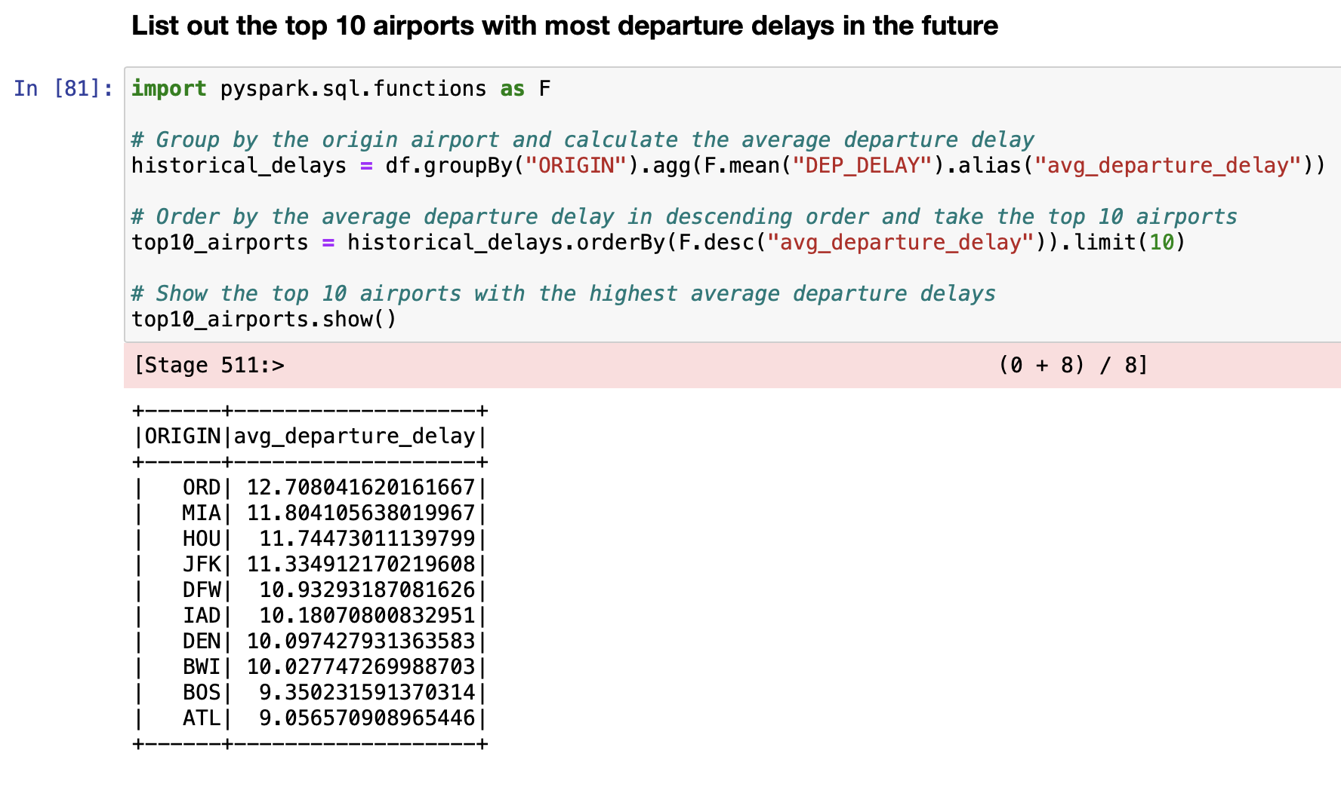
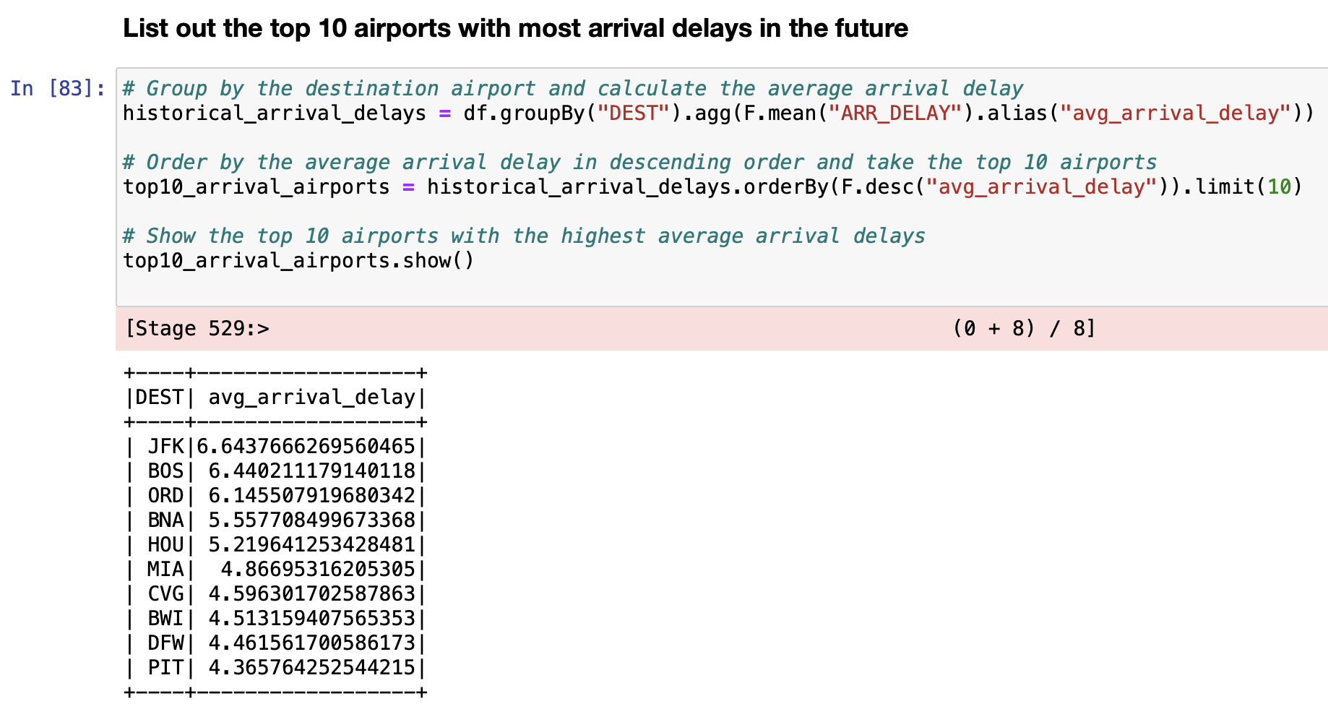
Predictions

Slide 24
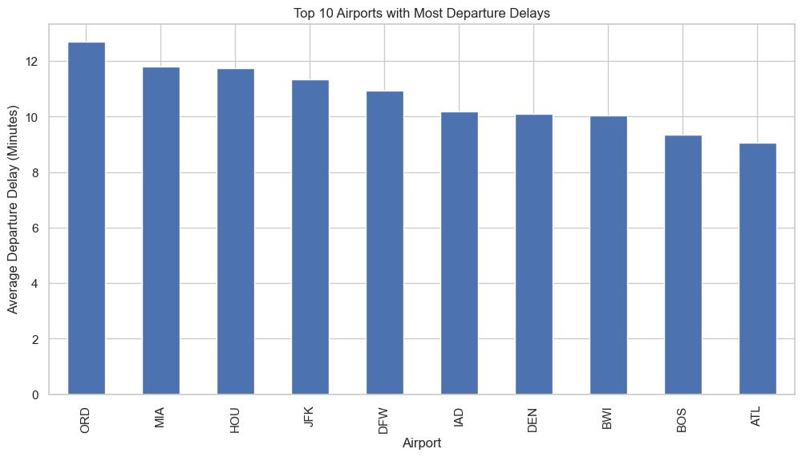
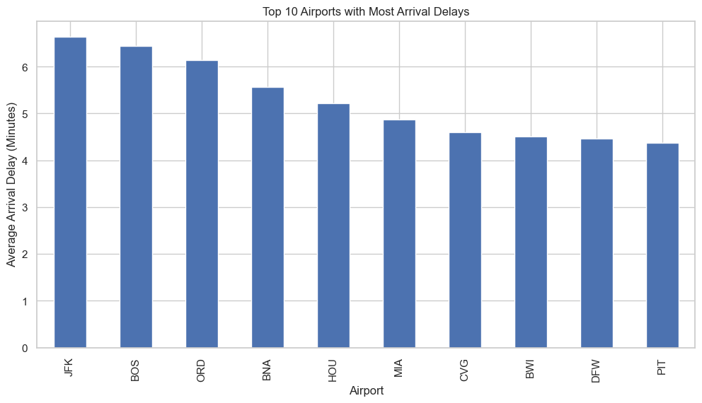
Data Visualization

Slide 25
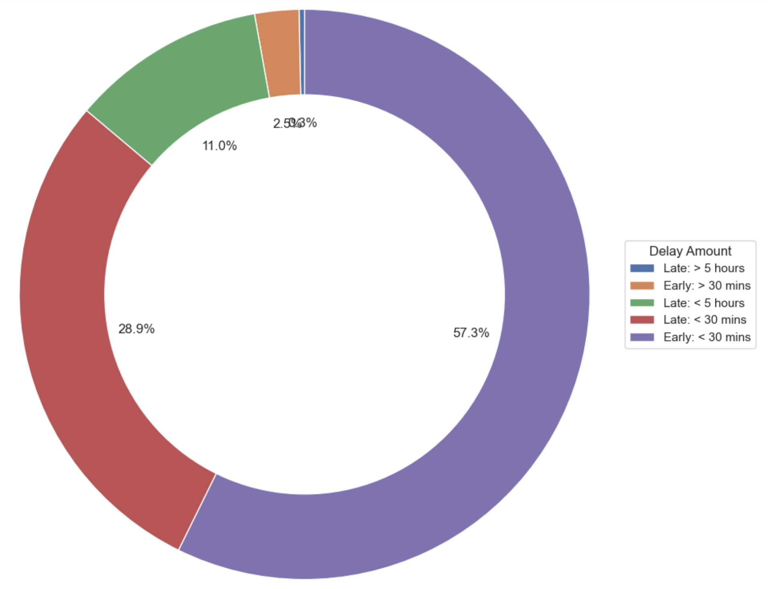
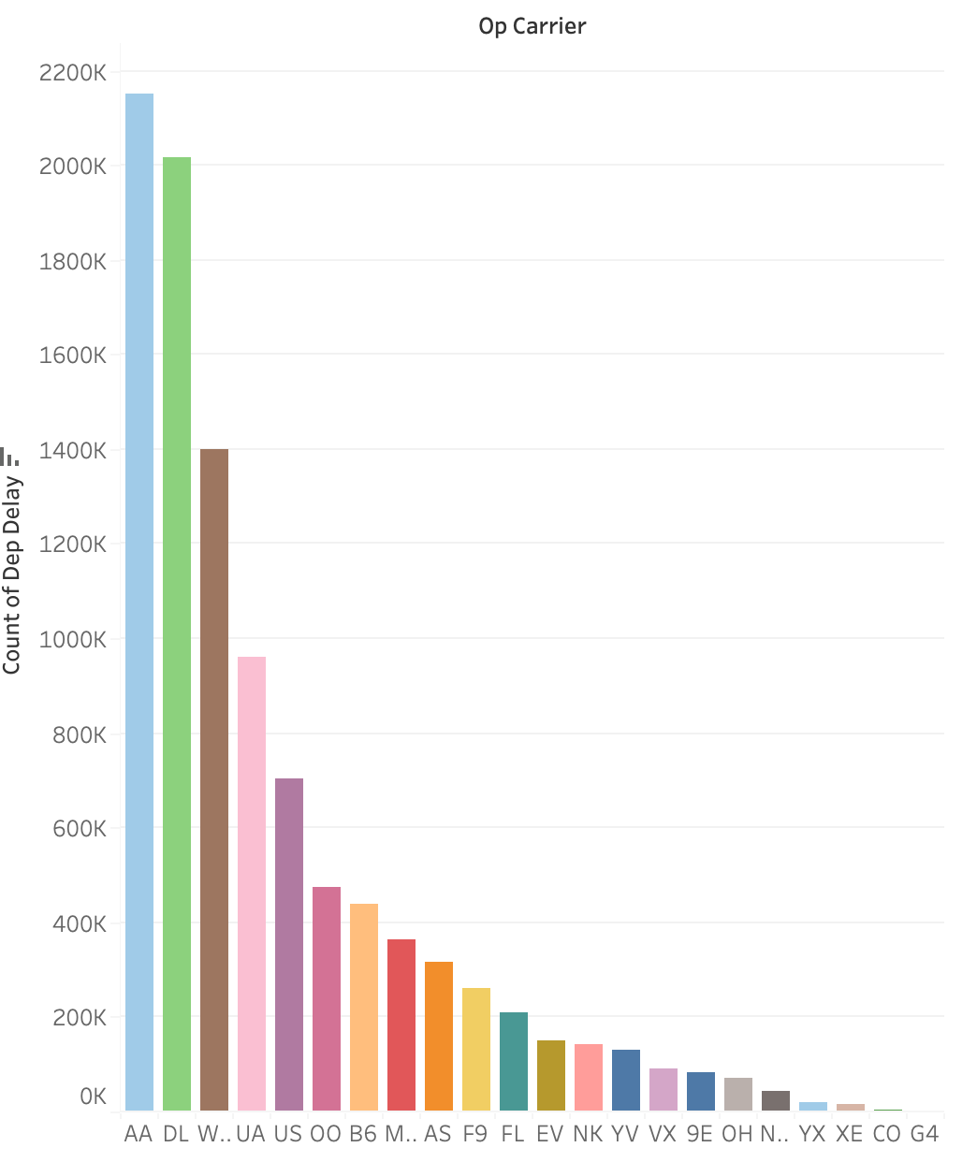
Visualizations Using Tableau
Percentage of flights based on delay amount
Airlines with most DEP DELAY

Slide 26
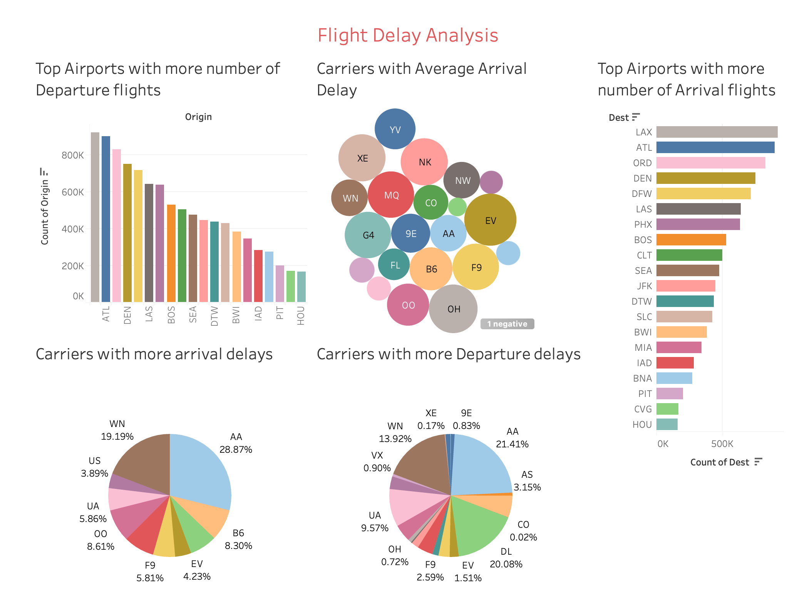
Tableau Dashboard

Slide 27
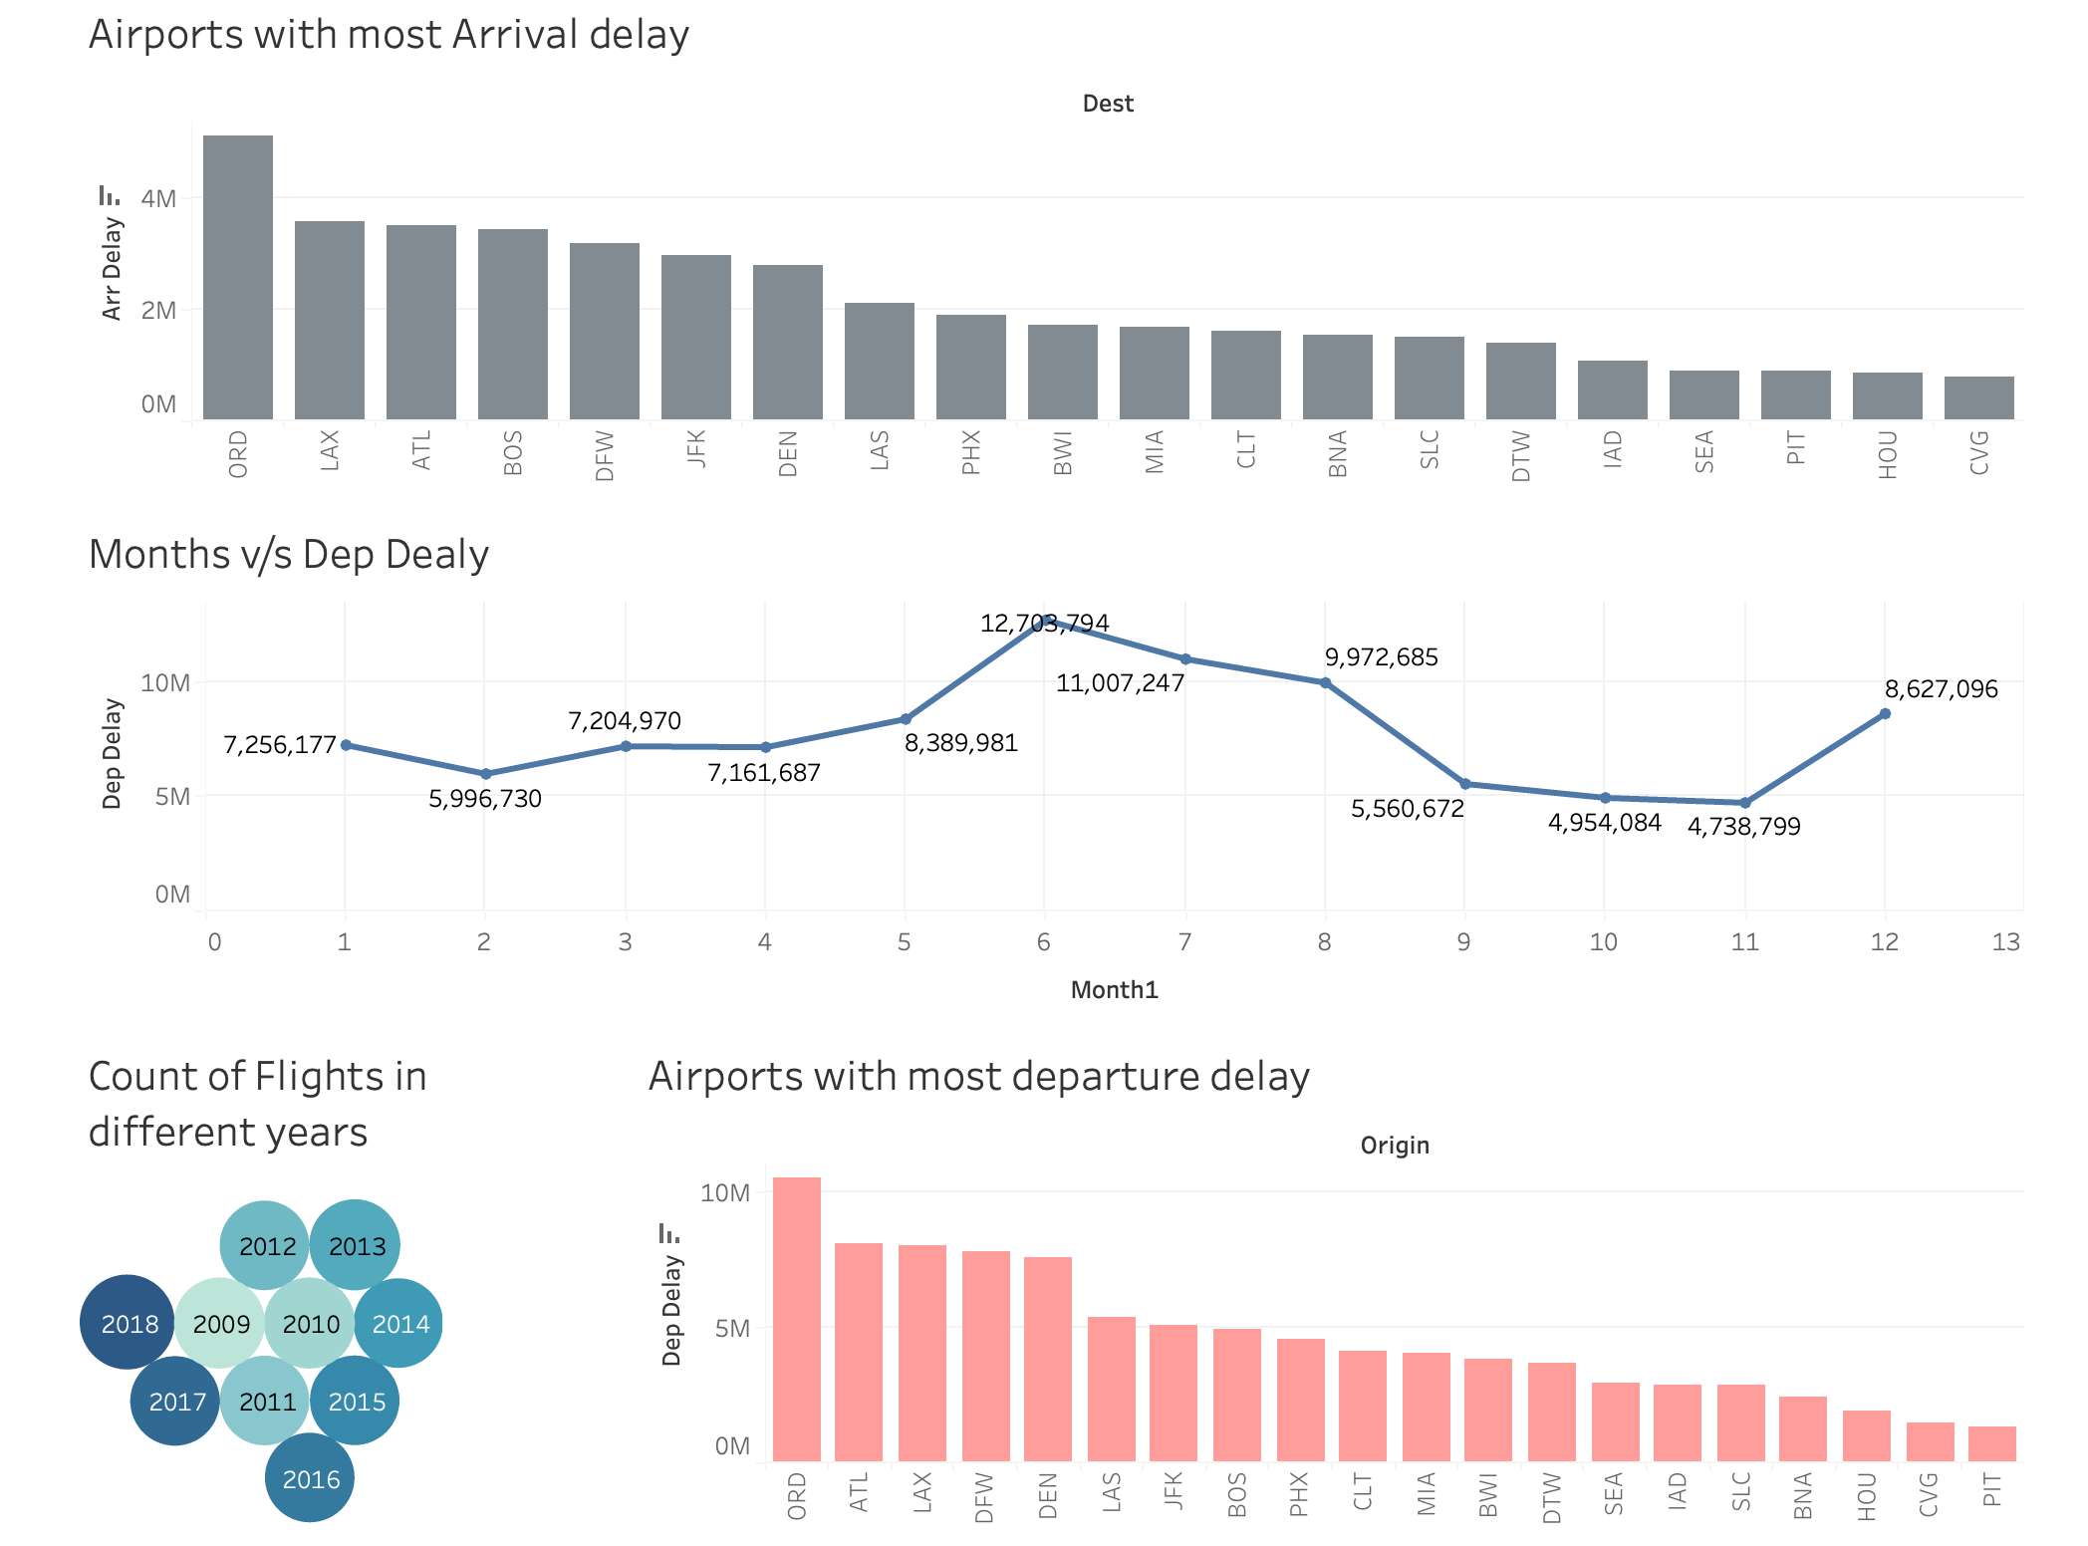
Tableau Dashboard

Slide 28
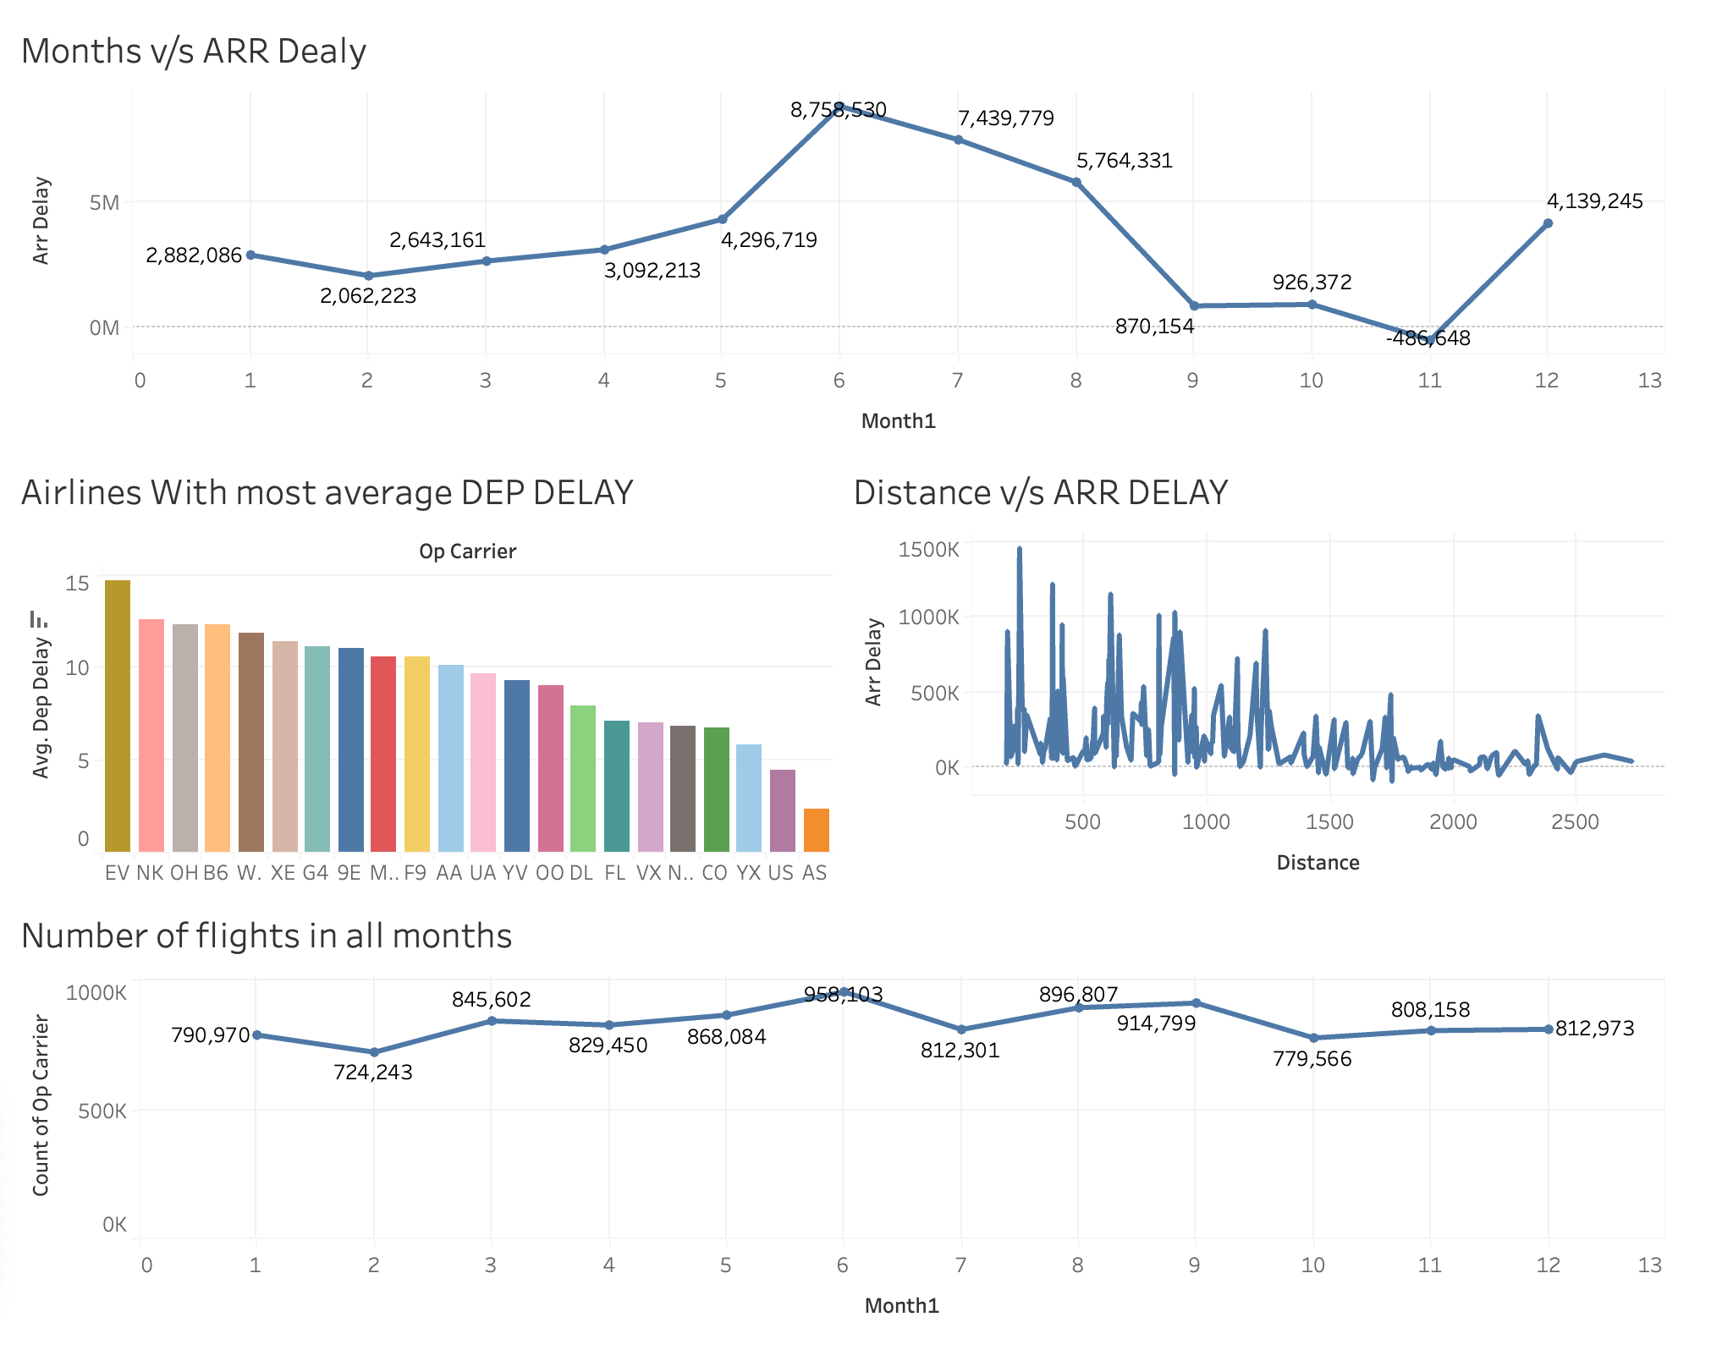
Tableau Dashboard

Slide 29
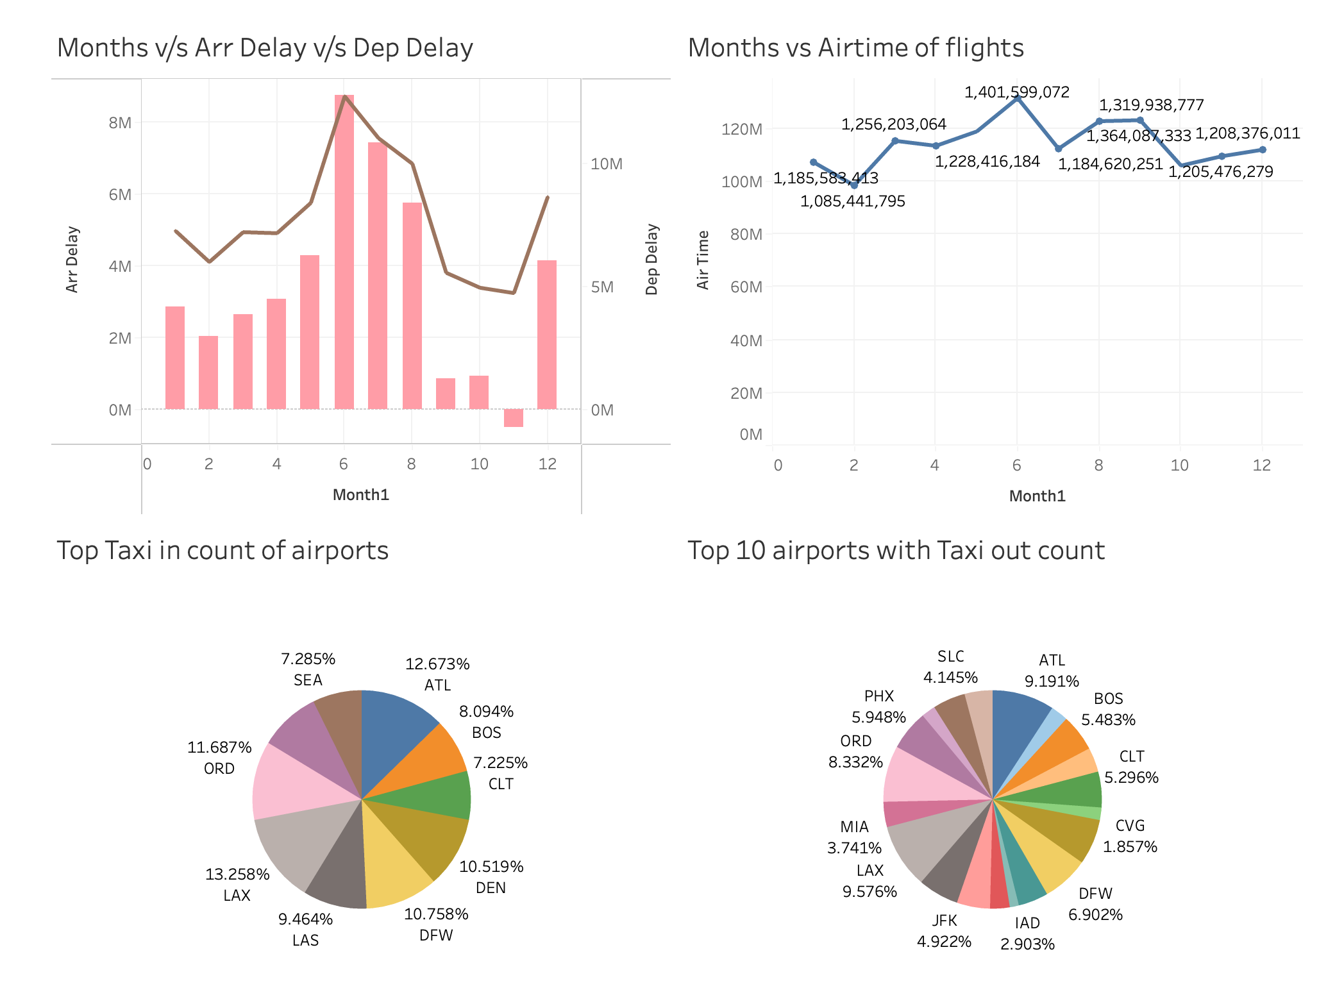
Tableau Dashboard

Slide 30
Conclusions
Los Angeles International Airport (LAX) has the maximum number of departure and arrival flights
Los Angeles International Airport (LAX) is the busiest airport, followed by Atlanta (ATL).
From our analysis, we found that American Airlines has the most delays.
June and July are the months with higher flight delays while October and November have less flight delays.

Slide 31
Conclusions
The month of June sees a higher volume of flights and February month experiences a lower number of flights.
Most arriving flights typically fall within the time range of being less than 30 minutes ahead of schedule.
Based on r2 score and RMSE we found that Linear regression has accurately predicted the delays compared to other models.

